Slide 1
Gender Based Violence
By Melissa Boissiere
M.A. Candidate
Kimberly Green Latin American and Caribbean Center (LACC), FIU

Slide 2
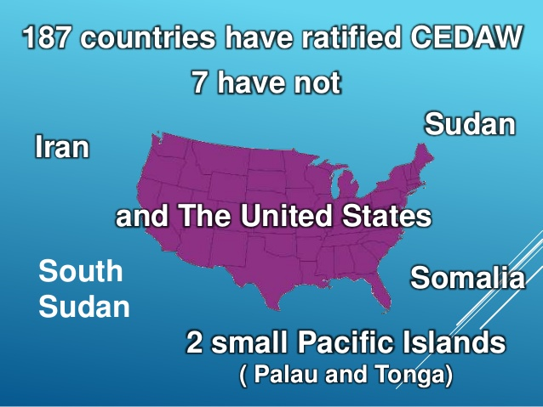
INTERNATIONAL INSTRUMENTS

Slide 3
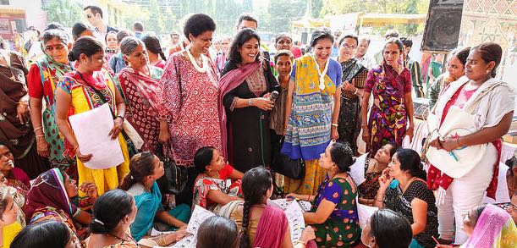
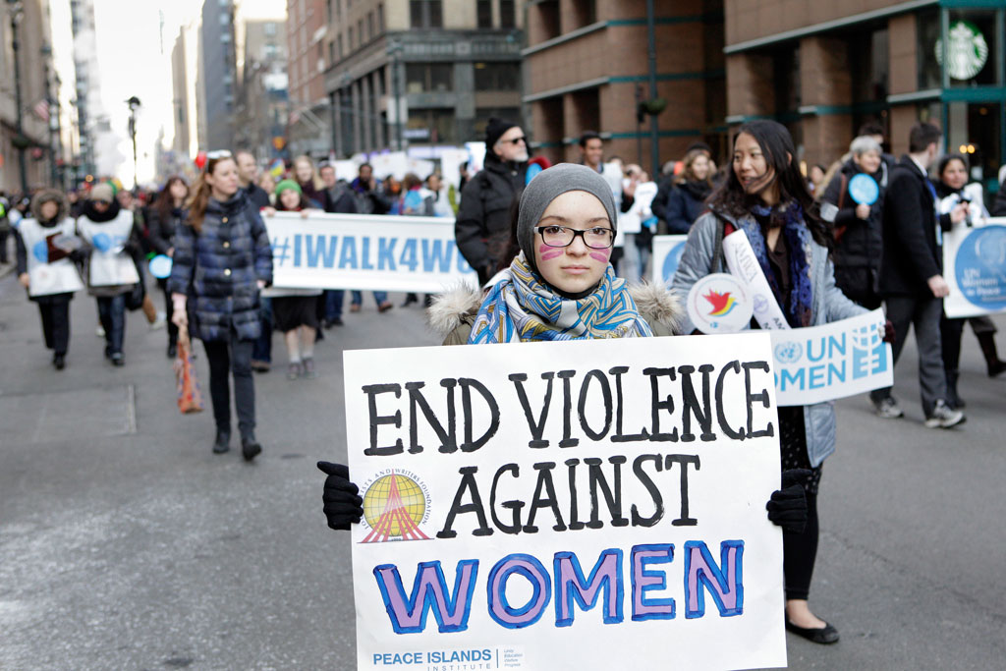
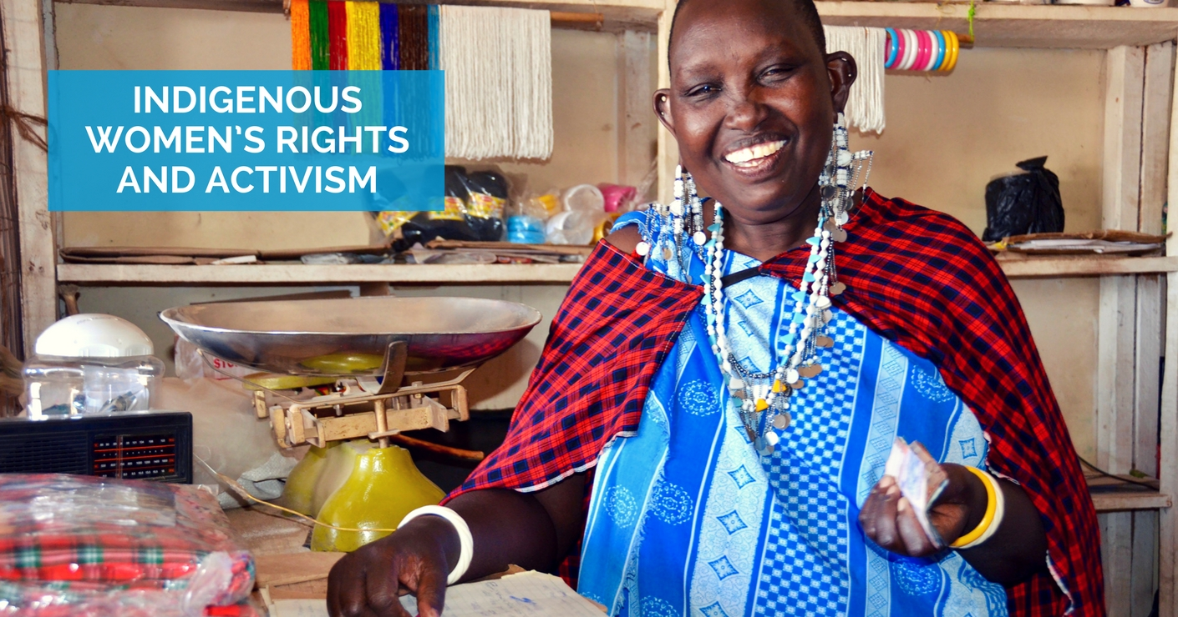
Convention on the Elimination of all Forms of Discrimination Against Women (CEDAW)

Slide 4
CEDAW
Protection from discrimination in:
Education
Employment
Family and social life
Statehood-related issues
Economic activities
Civil and political spheres
Business
Command over property

Slide 5
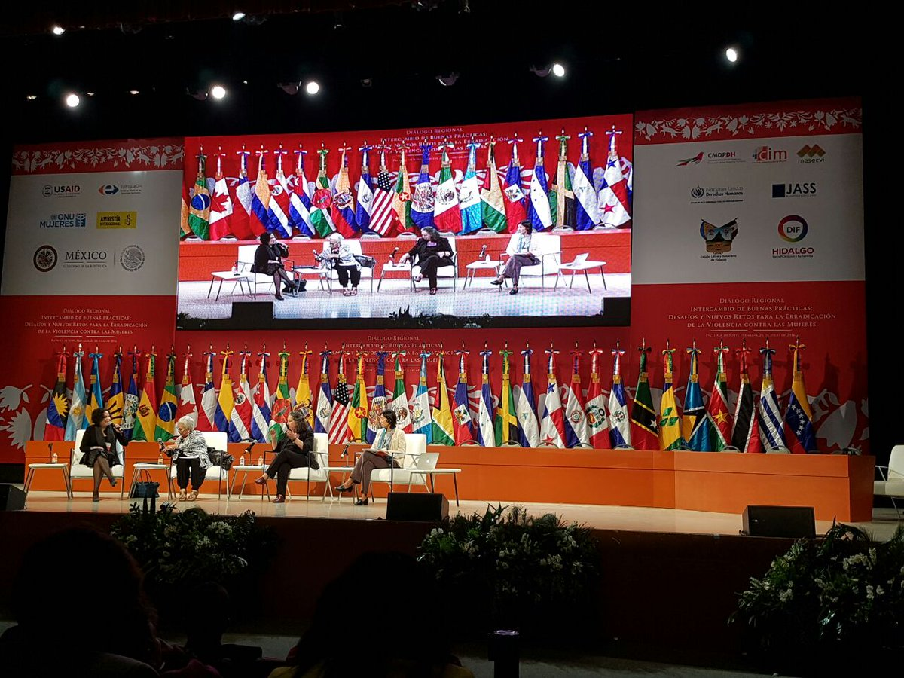
Inter-American Convention on the Prevention, Punishment and Eradication of Violence Against Women

Slide 6
Belem do Para Convention
Definition of violence against women:
Any conduct based on gender, which causes death or physical injury, sexual or psychological harm or suffering to women, whether in the public or private sphere
Adopted in 1994, Belem do Para, Brazil
Entered into force in 1995

Slide 7
Statistics
FORM OF VIOLENCE | WOMEN AFFECTED
Physical or sexual violence Some national studies on this | 35 % Up to 70 %
Sexual Harassment in Washington D.C. | 1 in 4
Sexual assault or misconduct in US universities | 23 % of female undergraduate student
Rape / forced sexual acts | 120 million girls (a little more than 1 in 10)
Trafficking for the purpose of sexual exploitation | Nearly 3 out of 4
School-related violence | 246 million girls and boys
Psychological violence in EU | 43 %

Slide 8
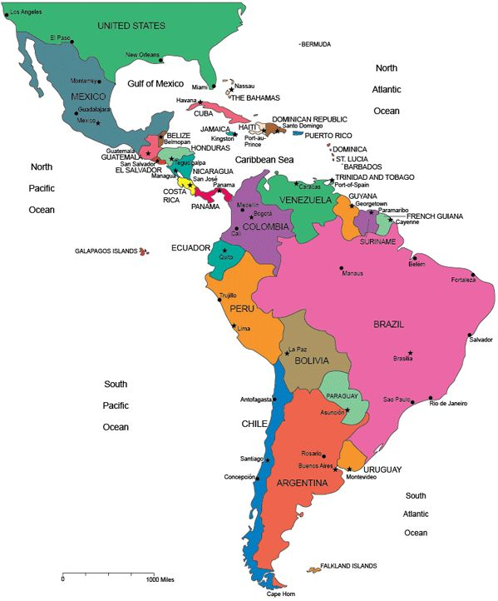
Manifestations and scope – LAC, OECS

Slide 9
Conclusions
Violence against women and girls remains pervasive
Not adequately addressed in legislation, policies or practice
Violence is also experienced in schools
Encourage non violence
Solutions are multifaceted
Important role of schools in changing unhealthy behaviors

