Slide 1
The Cuban Missile Crisis: An Exercise in Crisis Decision-Making
Spring 2017 High School Student Simulation
Feb. 15th, 2017 MMC - GC Ballrooms
In Partnership with the
Division of Social Sciences and Life Skills
Miami-Dade County Public Schools

Slide 2
Program in National Security Studies
Spring 2017 High School Simulation
February 15th, 2017 8:00 AM – 12:30 PM Modesto A. Maidique Campus, GC Ballrooms
AGENDA
8:00 a.m. to 9:00 a.m. | Registration
9:00 a.m. to 9:45 a.m. | Welcome and Simulation Overview: Hector Cadavid, Assistant Director, Gordon Institute Dr. Brian Latell, Senior Research Analyst, Gordon Institute Aldo Fonseca, Outreach Coordinator
10:00 a.m. to 10:40 a.m. | Round 1: Inner-group discussion round
10:40 a.m. to 11:20 a.m. | Round 2: Negotiation round
11:20 a.m. to 12:00 p.m. | Round 3: Presidential Memorandum
12:00 p.m. to 12:30 p.m. | Debrief and Summer Institute Information
In Partnership with the
Office of Curriculum and Instruction,
Social Sciences
Miami-Dade County Public Schools

Slide 3
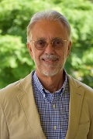
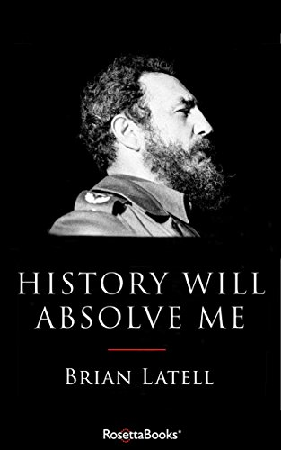
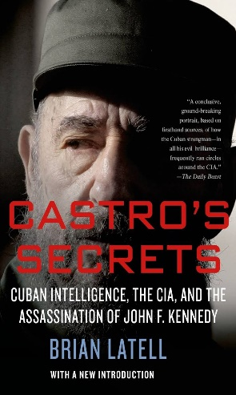
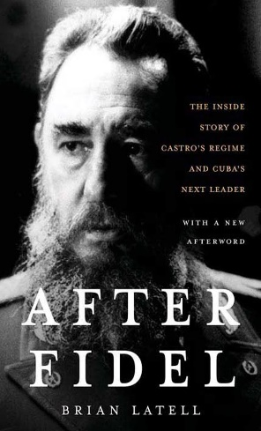
Program in National Security Studies
Spring 2017 High School Simulation
February 15th, 2017 8:00 AM – 12:30 PM Modesto A. Maidique Campus, GC Ballrooms
Dr. Brian Latell
Dr. Brian Latell has been a Latin America and Caribbean specialist for more than four decades. During his 35 years of service in the CIA and National Intelligence Council he advised the White House and other ranking American officials and members of Congress on Latin American developments.
In Partnership with the
Office of Curriculum and Instruction,
Social Sciences
Miami-Dade County Public Schools

