Slide 1
Histories of Historical Myths in Latin America:
Bianca Premo
Conquest
Black Legend
Benign Slavery
The Immature Pueblo
Racial Democracy
Spellbound by Dictators

Slide 2
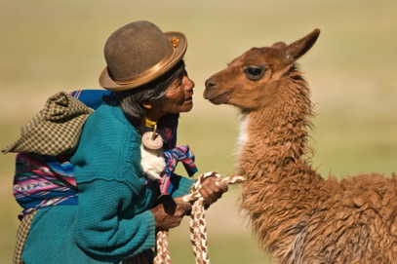
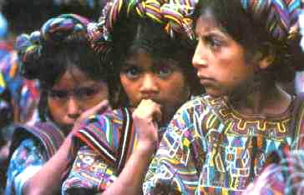
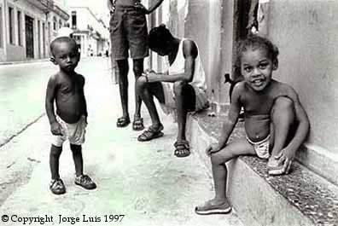
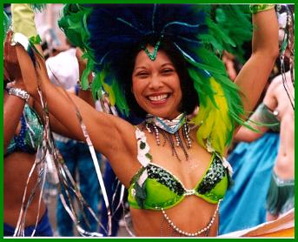
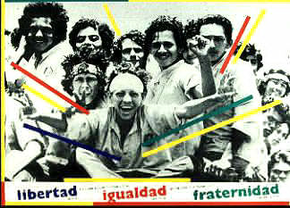

Slide 3
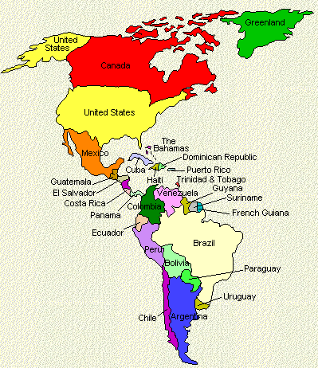
Modern Latin America
20 Countries, One History?
North America
Caribbean
Central America
South America

Slide 4
Colonialism
19th Century
20th Century
1492
182
0
1850
1870
1898
191
0
1930
1960
1970
1980
Independence
Popular Politics
Conquest
Early Colonialism
Civil Wars
Cold War, Revolutions
and Dirty Wars
Living in an Empire
Neo-Colonialism
Re-democratization

Slide 5
Conquest
Myth: A small regiment from the Spanish army, led by capable and astute men such as Hernán Cortés and Francisco Pizarro, defeated hundreds of thousands of natives
History: diverse Europeans and some Africans, acting on their own, along with thousands of native allies, began a long process of establishing Spanish sovereignty that lasted for centuries
Historicizing the myth

Slide 6
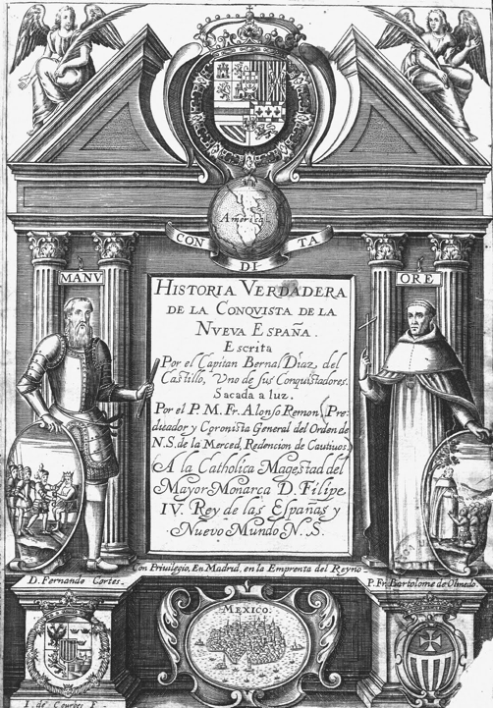

Slide 7
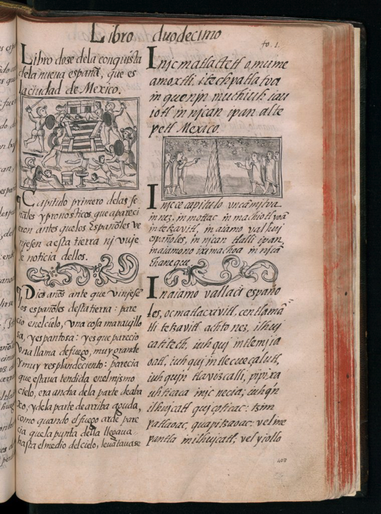
Florentine Codex
Compiled by Fray Bernardo Sahagún
1555

Slide 8
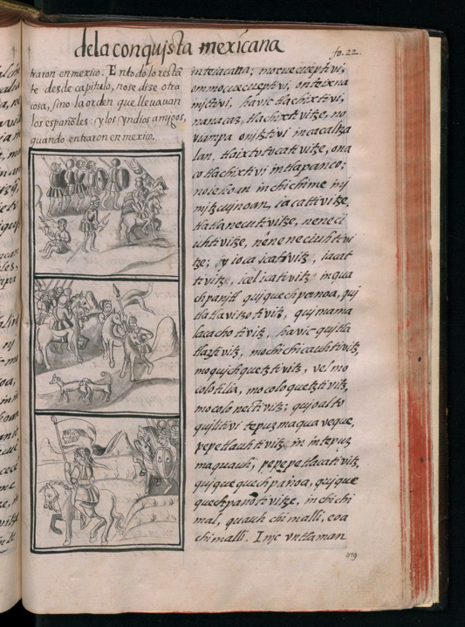

Slide 9
Black Legend
Myth: The Spanish claims to legitimate possession of the lands of the New World were faulty, based in brutality, and reflected backward medieval thinking about the world
History: Political motivations lay behind each iteration of the myth (Las Casas ca 1540s; British and French in 18th and 19th centuries; 20th-century economic developmentalists
Historicizing the Myth

Slide 10
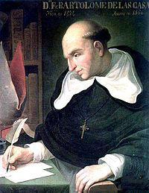
Yet into this sheepfold, into this land of meek outcasts there came some Spaniards who immediately behaved like ravening wild beasts
-Bartolomé de las Casas

Slide 11
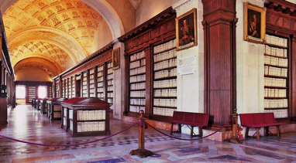
Since this edition was put into the press, a History of Mexico, in two volumes in quarto, translated from the Italian of the Abbe D. Francesco Savario Clavigero, has been published. From a person, who is a native of New Spain, who has resided forty years in that country and who is acquainted with the Mexican language, it was natural to expect much new information…Upon perusing his work, however, I find that it contains hardly any addition to the ancient History of the Mexican empire…but what is derived from the improbable narratives and fanciful conjectures.
- William Robertson, Preface to 3rd ed. History of America (1777-93)
Archive of the Indies, Sevilla, Spain

Slide 12
Benign Slavery
Myth: Slavery in Spanish America and Brazil was less harsh than slavery in British North America because of the propensity toward race mixture, manumission practices, and lack of capitalism
History: Latin America, and particularly Brazil, accounted for the vast majority of slave importations. Manumission more common but still rare. Imports rather than reproduction.
Historicizing the myth

Slide 13
Trans-Atlantic imports of African slaves
by region
1450-1900
Region # accounted for %
Brazil 4,000,000 35.4
Spanish Empire 2,500,000 22.1
British West Indies 2,000,000 17.7
French West Indies 1,600,00 14.1
British North America & US 500,000 4.4
Dutch West Indies 500,000 4.4
Danish West Indies 28,000 0.2
Europe (and Islands) 200,000 1.8
Total 11,328,000 100.0

Slide 14
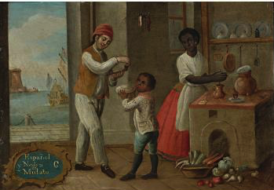
“Casta” painting
More on myths of slavery!
http://www.gilderlehrman.org/history-by-era/origins-slavery/resources/myths-and-misconceptions-slavery-and-slave-trade

Slide 15
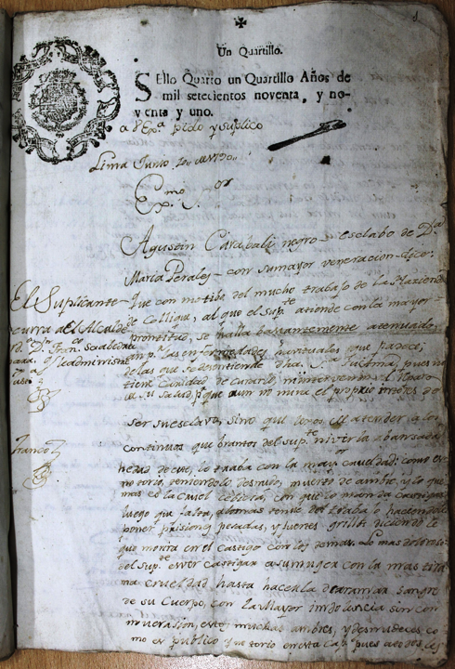

Slide 16
The Immature Pueblo
Myth: Latin Americans emerged from Independence (ca 1820-1898)
unprepared for political liberalism, thus leaving populations vulnerable
to local military strongmen (caudillos, coroneis) who replaced the king
History: Even under monarchies (Cuba, Brazil, Mexico in 1860s) instituted liberal reforms in economics, electoral processes, civic life. Thriving presses, party identification even without suffrage, deep culture of first “patria chica” (local national identity), then broader national identity
Historicizing the myth

Slide 17
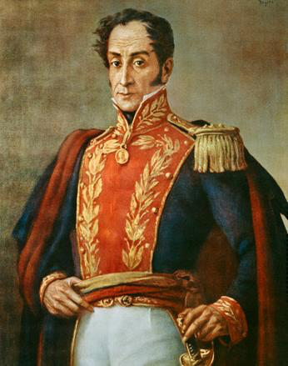
Simón Bolívar
Jamaica Letter, 1817
Despite the convictions of history, South Americans have made efforts to obtain liberal, even perfect, institutions, doubtless out of that instinct to aspire to the greatest possible happiness, which, common to all men, is bound to follow in civil societies founded on the principles of justice, liberty, and equality. But are we capable of maintaining in proper balance the difficult charge of a republic?

Slide 18
Domingo F. Sarmiento
President of Argentina 1870s-80s
Liberal educator, anti-conservative

Slide 19
Racial Democracy
Myth: Latin Americans are more racially tolerant and because of propensity to
mix races (miscegenation) historically have experienced less discrimination
History: Claims of racial democracy and myths of inclusive race-mixing have made discussion of actual discrimination and economic disparities seem unpatriotic (as but one example, whiter Brazilians made 2X what darker Brazilians made in salary in 2007). Indigenous Latin Americans often more important symbolically than politically.
Historicizing the myth

Slide 20
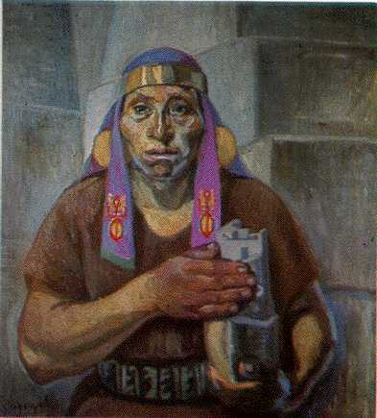
“Indigenismo” in art
José Sabogal (Peru, 1888-1956)

Slide 21
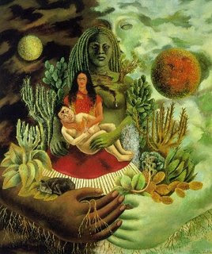
Frida Kahlo
(Mexico 1907-59)

Slide 22
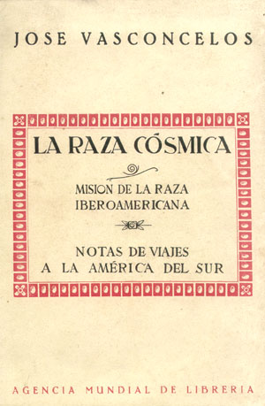
José Vasconcelos
“Cosmic Race” 1925

Slide 23
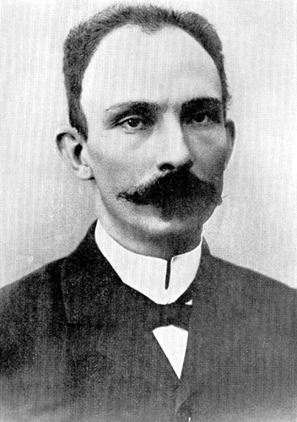
José Martí
Our America, Cuba 1891

Slide 24
Spellbound by Dictators
Myth: Latin Americans prefer individuals over institutions in politics, and thus
have been dominated by dictators– often military-- in the 20th and 21st centuries
History: Scholars have argued that it is not a “cultural affinity” for populist, charismatic leaders but rather the elites’ hold over weak institutions that had Latin American countries swinging between authoritarian regimes and democracy in the 20th century.
Historicizing the myth

Slide 25
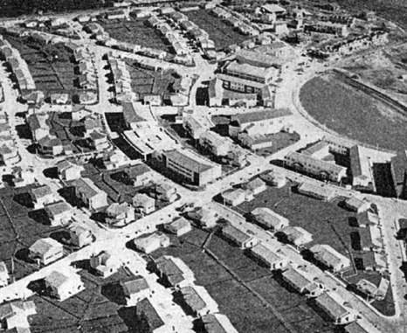
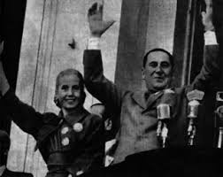
Juan Perón
1946-55; 1973-4
Barrio Presidente Perón

Slide 26
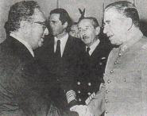
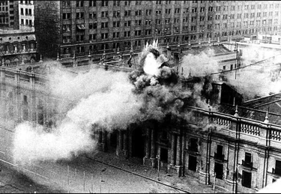
US Secretary of State Henry Kissinger
With General Augusto Pinochet 1970
What are we going to say when other countries start to democratically elect other Salvador Allendes?

