Slide 1
Haitian Youth and Wholeness

Slide 2
What do you know about Haiti? What are your experiences with Haitian children & families?
Reflection Activity

Slide 3
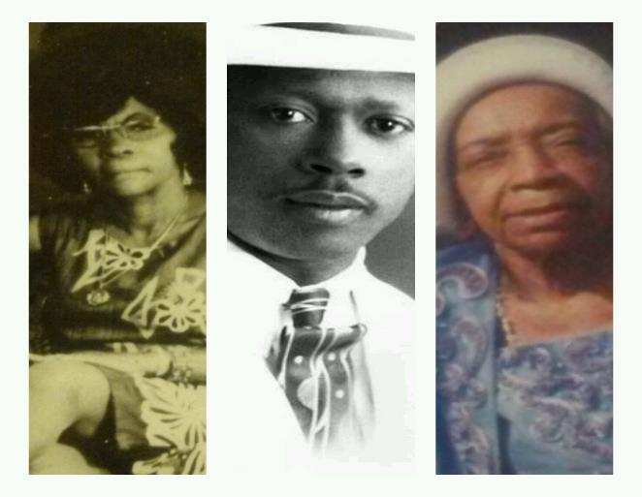
Haitian Ancestral Epistemology

Slide 4
What is your ancestral History? How does it influence your life & your work?
Reflection Activity

Slide 5
LÒT BÒ DLO
1514 – 1804 - 70s – 80s – 90s – 2000s

Slide 6
Have you imagined your descendants 213 years from now?
Reflection Activity

Slide 7
Haitian American vs. American Haitian

Slide 8
Bourik Fè Pitit pou dÒl Poze
Opportunities
Sacrifice in Transition
Lessen Burden
Balance
Responsibility
Acknowledgment

Slide 9
Transitional Recovery
Migration as a Social Wellness Threat
Repairing Trauma of Transition
Multiple Conflicting Contexts

Slide 10
Haitian American Demographics

Slide 11
Population reporting Haitian ancestry in 2009

Slide 12
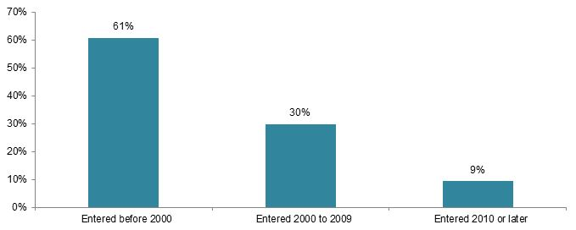
Migration By arrival Source: MPI tabulation of data from the U.S. Census Bureau 2012 ACS.

Slide 13
Characteristics of Haitians in the us
Haitian households tend to be larger, family households.
3.7 people compared with 2.6 people for total population
Approximately 59% of Haitians are foreign-born.
81% speak a language other than English at home.
Higher rates of Haitians in the labor market, yet lower earnings
Median earnings for full-time, year round Haitian male workers was $12,000 less than the total population and $7,000 less for females

Slide 14
Characteristics of Haitians in the us (continued)
Median Haitian family income is lower
$46,000 compared to $61,000 for the total population
1 in 5 Haitians live in poverty (20%) compared with 1 in 7 n the total population (14%)
Homeownership is lower for Haitian households
47% owner-occupied compared with 66% of total U.S. households

Slide 15
Education Attainment -BA
Haitian Women --- 27.4%
https://www.youtube.com/watch?v=xHhngXU8Zw4
Haitian Men 28.4%
African Americans 19% (RACE)
http://www.clutchmagonline.com/2013/01/new-study-black-students-who-are-taught-racial-pride-do-better-in-school/
Overall U.S. 30%

Slide 16
The Lakou Concept Haitian Education Model
EDIKASYON
HOME
COMMUNITY
SCHOOL
CHURCH
LAKOU

Slide 17
Conflicted & Contradictory Knowledge
Home
Community
Church
School

Slide 18
Fragmenting a Successful Haitian Cultural Education Model
Integrated
Fragmented
EDIKASYON
HOME
COMMUNITY
SCHOOL
CHURCH
LAKOU
Education
Home
Community
School
Church
LAKOU

Slide 19
ACADEMIC Spaces of Building wholeness

Slide 20
Program for Haitian Youth
Haitian Epistemology
History of Program
L.I.F.E. and H.E.L.P. began as art-based literacy programs funded by Children’s Trust whose aim was using diverse methods to learn and provide academic tools to Haitian high school and middle school students in Miami who are under-achieving

Slide 21
The Mission of the Program
The mission of the Literacy Initiative for Empowerment Program (L.I.F.E.) and Haitian Empowerment Literacy Project (H.E.L.P.) is to provide a quality art-based program that would empower youth in the Miami-Dade community to make positive life choices, develop socio-cultural awareness, and to build literacy skills that will enable them to maximize their personal, interpersonal, and community potential.

Slide 22
Program Overview
ACADEMIC
CULTURAL
PHYSICAL FITNESS
PSYCHO-SOCIAL SKILL DEVELOPMENT
SPIRITUAL

Slide 23
Haitian principles Guiding Education for My Program
Gede - Life and Death -Self
Marasa – Duality –Self
Ezili – Love – Interpersonal
Simbi – Healing - Interpersonal
Legba – Crossroads - Community
Jeni – Individual Alignment - Community
Azaka – New Growth/Beginnings = Community

Slide 24
Program Themes
Year 1 - Manifestation of God’s Love
Year 2 – Decolonizing the Imagination
Year 3 – Dream Actualized
Year 4 – Spiritual Consciousness Connects us to a Divine Mind
Year 5 – The Roots are Deep
Year 6 - The School is the Church and the Church is the School
Year 7 – Beyond Liberation

Slide 25
Learning Triangulation
Visual
Audio
Oral
Written
Reflection
Sharing

Slide 26
Social StuDies and Haitian Youth
How do we support a strong academic identity of Haitian youth as they navigate and master a conflicting and contradictory academic and social context of school?

Slide 27
Areas of Social Critical Investigation & Proposed Student Activities
Student Riots for Civic Change in Haiti
Haiti in Global Context
Migration Patterns of Haitian in the Diaspora
Using Census Data to create Social Portrait of Haitians
Historical Relationship with Bolivia, Venezuela, US
Haitian Revolution as a lens for Black Consciousness in the Americas
http://www.clutchmagonline.com/2013/01/new-study-black-students-who-are-taught-racial-pride-do-better-in-school/

Slide 28
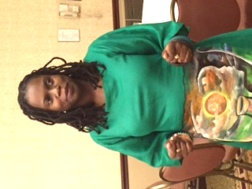
Dr. Charlene Desir NSU Ten, GLOBAL cdesir13@gmail.com

Slide 29
references
Bibb, A., & Casimir, G. J. (1996). Haitian families. Ethnicity and family therapy (2nd ed.) (pp. 97-111). New York, NY, US: Guilford Press, New York, NY.
De Santis, L., & Ugarriza, D. N. (1995). Potential for intergenerational conflict in cuban and haitian immigrant families. Archives of Psychiatric Nursing, 9(6), 354-364. doi:http://dx.doi.org.ezproxy.fiu.edu/10.1016/S0883-9417(95)80059-X
Ferguson, G. & Desir, C. (2014). Ayiti Cheri: Cultural Orientation of Early Adolescents in Rural Haiti. The Journal of Early Adolescence, 34, (5), 620-636.
Desir, C. (2011). (Invited) Diasporic Lakou: A Haitian Academic Explores her Path to Haiti Pre and Post Earthquake. Harvard Educational Review, 82 (2), 278-295
Desir, C. (2008). Understanding the Sending Context of Haitian Immigrant Students. Journal of Haitian Studies, 13 (2), 73-93.
Desrosiers, A., & St. Fleurose, S. (2002). Treating haitian patients: Key cultural aspects. American Journal of Psychotherapy, 56(4), 508-521.
Doucet, F. (2011). (Re)constructing home and school: Immigrant parents, agency, and the (un)desirability of bridging multiple worlds. Teachers College Record, 113(12), 2705-2738.
Doucet, F. (2011). Parent involvement as ritualized practice. Anthropology & Education Quarterly, 42(4), 404-421. doi:http://dx.doi.org.ezproxy.fiu.edu/10.1111/j.1548-1492.2011.01148.x
Felix, K. (2007). An examination of the relationship between family-of-origin health and marital satisfaction in protestant haitian american couples Available from PsycINFO. (622034217; 2007-99200-519).
Francois, A. J. (Mar 1998). A manual of counseling and psychotherapy for minority immigrants of haitian descent Available from PsycINFO. (619374061; 1998-95006-374).
Giles, H. C. (Feb 1992). The development of an instrument to assess the functioning of haitian immigrant families Available from PsycINFO. (618194513; 1992-76157-001).
Gopaul-McNicol, S., Benjamin-Dartigue, D., & Francois, E. (1998). Working with haitian canadian families. International Journal for the Advancement of Counselling, 20(3), 231-242. doi:http://dx.doi.org.ezproxy.fiu.edu/10.1023/A:1005368204341
Hall, P. & Batchelor, L. (2015). Psychological Well-Being and Personality of Haitian-American Adults. American Psychological Association Conference. August.
Jackson-Smith, P. D. (2008). The role of resiliency in the journey from welfare to self-sufficiency for former welfare recipients: A quantitative study Available from PsycINFO. (621717339; 2008-99030-549).
James, R., Sr. (2007). Jamaican migration theory: Shift in family dynamics in jamaican families that migrate from jamaica to the united states Available from PsycINFO. (622006340; 2007-99002-195).
Jean, C. (May 2003). Parent education training for haitian parents: A program design Available from PsycINFO. (620239599; 2003-95010-267).

Slide 30
References (con’t)
Johnson, M. E. (2010). An examination of the mediating effects of psychosociocultural factors, and neighborhood characteristics on depression symptomatology: A comparison of afro-caribbeans and african americans Available from PsycINFO. (822366903; 2010-99210-505).
Lee, M. K. (2008). Temporal changes in immigration stress, adaptation, and the factors contributing to the immigration-adaptation process in newly immigrant parents Available from PsycINFO. (621720516; 2008-99040-382).
Menos, J. (2005). Haitian families. New York, NY, US: Guilford Press, New York, NY.
Michel, J. (2004). Identity development of young women from haitian immigrant families in the united states: A qualitative exploratory study Available from PsycINFO. (620624207; 2004-99006-252).
Nicholas, T., Stepick, A., & Stepick, C. D. (2008). "Here's your diploma, mom!" family obligation and multiple pathways to success. Annals of the American Academy of Political and Social Science, 620(1), 237-252. doi:http://dx.doi.org.ezproxy.fiu.edu/10.1177/0002716208322781
Nicolas, G., Desilva, A., Prater, K., & Bronkoski, E. (2009). Empathic family stress as a sign of family connectedness in haitian immigrants. Family Process, 48(1), 135-150. doi:http://dx.doi.org.ezproxy.fiu.edu/10.1111/j.1545-5300.2009.01272.x
Nicolas, G., DeSilva, A., & Rabenstein, K. (2009). Educational attainment of haitian immigrants. Urban Education, 44(6), 664-686. doi:http://dx.doi.org.ezproxy.fiu.edu/10.1177/0042085908322704
US Census American Community Survey 2009
US Census American Community Survey 2012

