Slide 1
Images for the Gallery Walk:
Why do people move or immigrate?

Slide 2
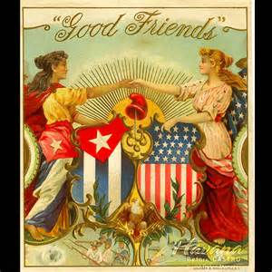
Cuba before 1959

Slide 3
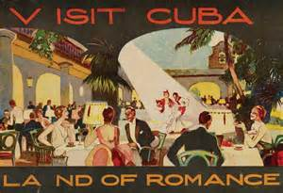
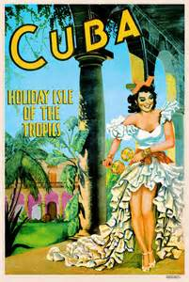
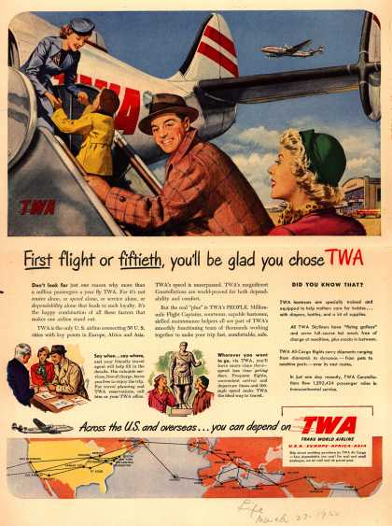
Popular Tourist destination:

Slide 4
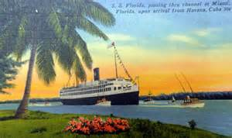
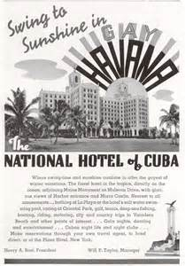

Slide 5
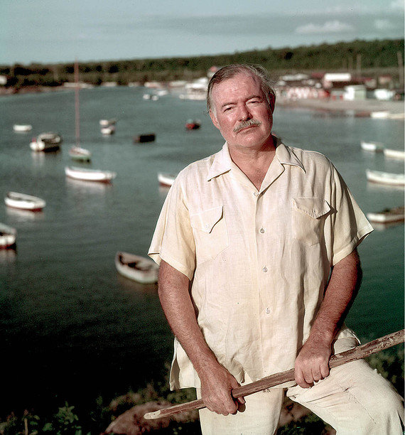
US involvement: Hollywood Glamour

Slide 6
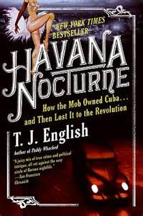

Slide 7
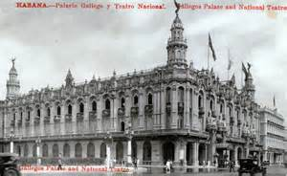
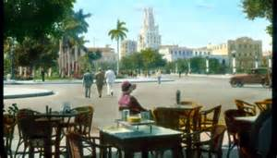
City of Havana:“Paris of the Caribbean”

Slide 8
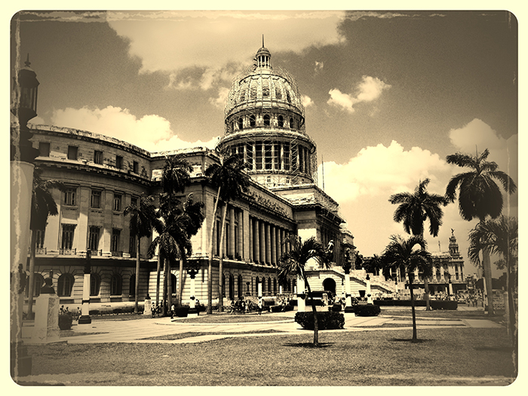
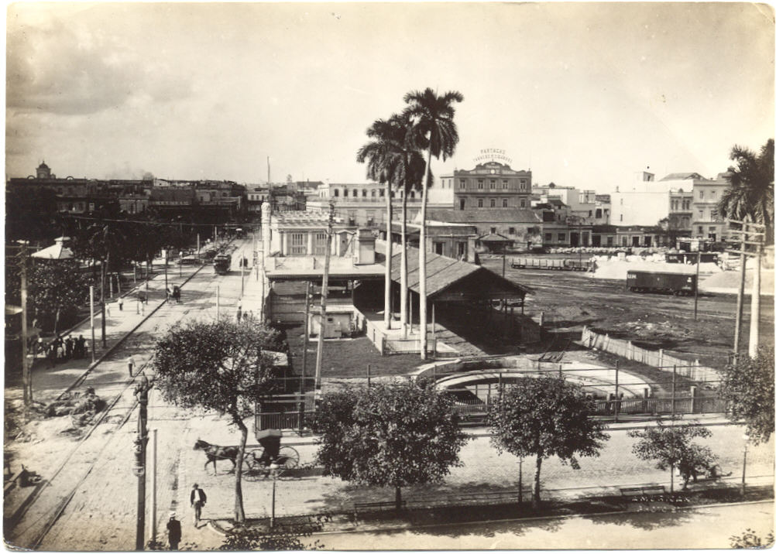

Slide 9
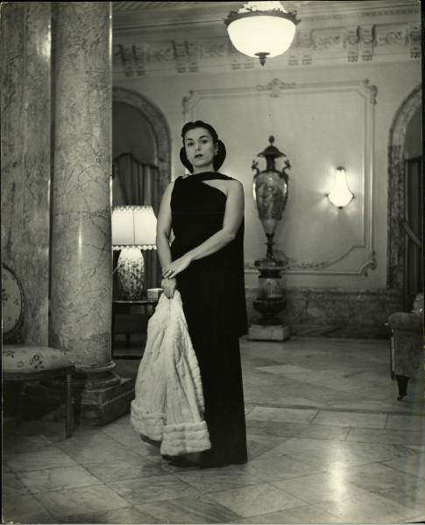
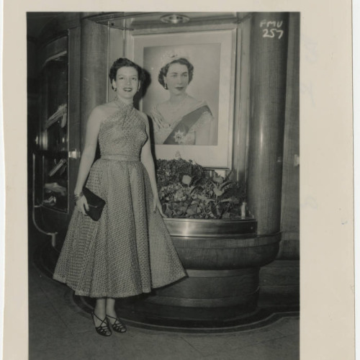
Cubans:

Slide 11
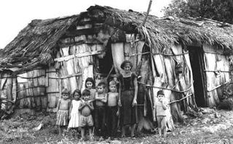

Slide 13
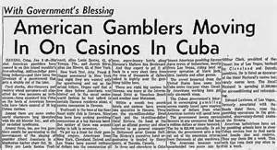
Corruption:

Slide 14
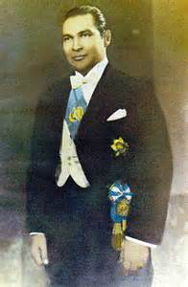
President: Fulgencio Batista

Slide 16
January 1, 1959:

Slide 17
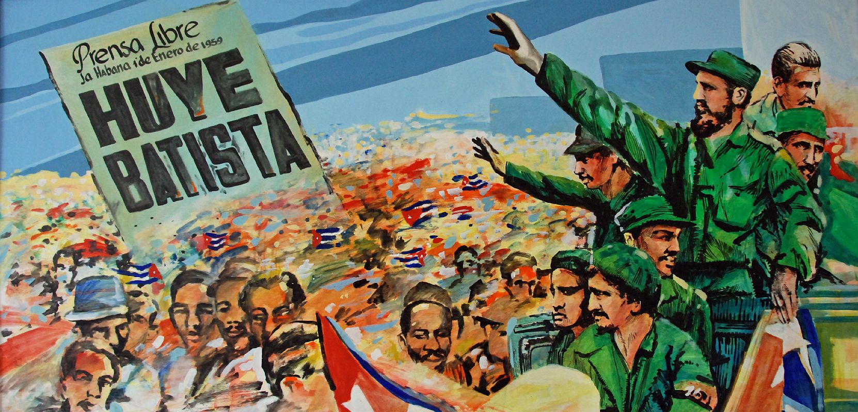

Slide 18
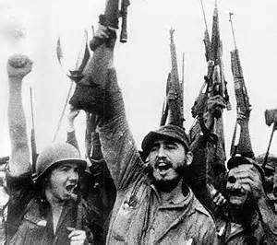
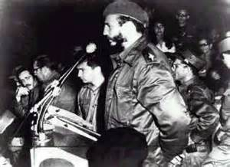
Fidel Castro:

Slide 19
Cuban Revolution:

Slide 20
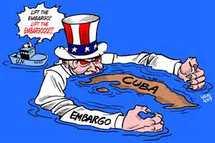

Slide 21
Allied with USSR: Communism

Slide 22
Cuban Immigration: Circa 1959 to 1968

Slide 23
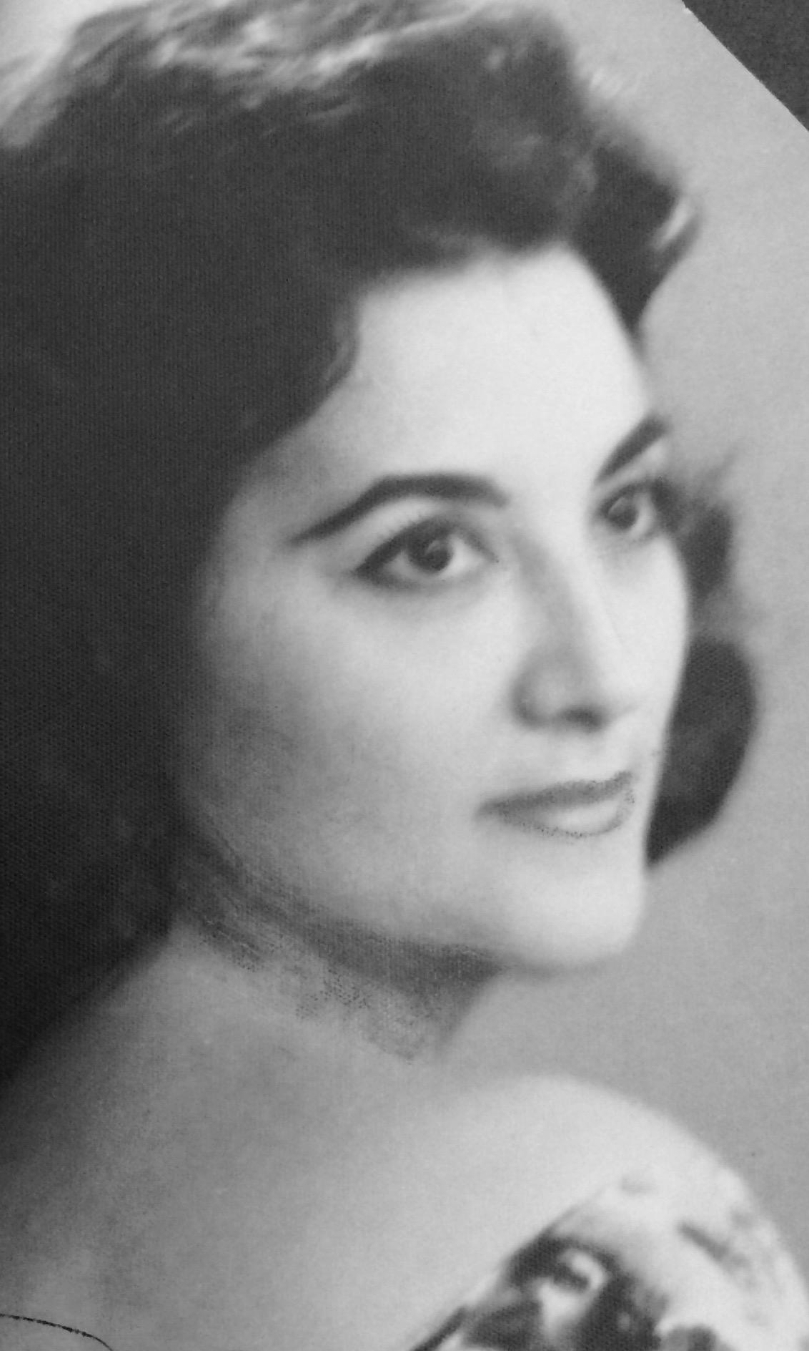
My Parents:

Slide 24
My Brother:

Slide 25
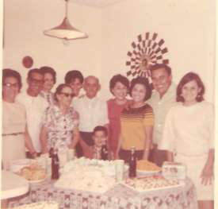
My Grandfather-Don Benjamin and his Family:

Slide 29
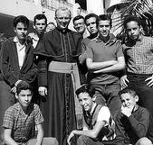

Slide 30
Freedom Tower:

Slide 31
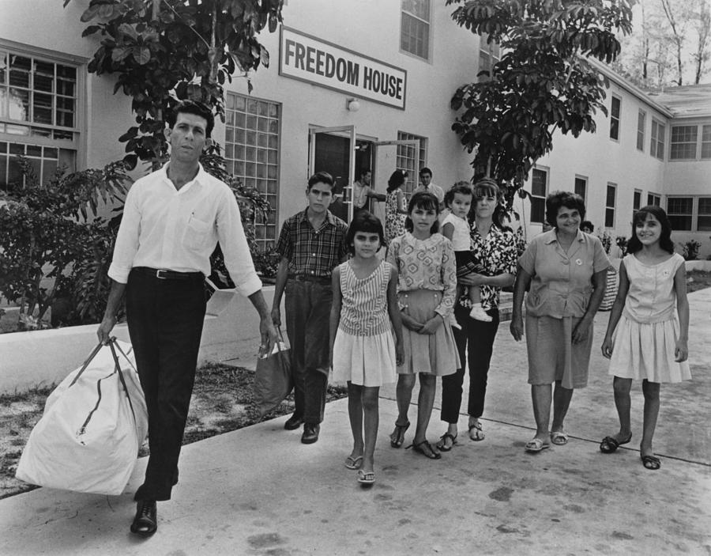

Slide 33
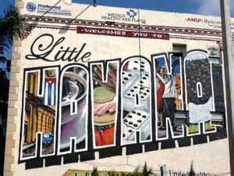
Enclaves:

Slide 36
Ellis Island:

Slide 37
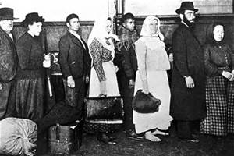

Slide 39
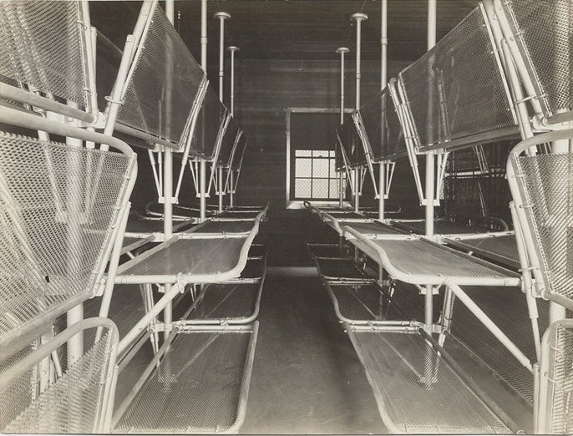
Angel Island:

Slide 40
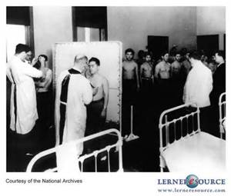

Slide 41
What do you think?

Slide 42
http://vintagecuba.tumblr.com
https://petitequaintrelle.wordpress.com/2013/09/25/aline-johnson-de-menocal/
https://www.youtube.com/watch?v=q9Hhf8kEJIg https://www.youtube.com/watch?v=ScgJyQAT9OQ

