Slide 1
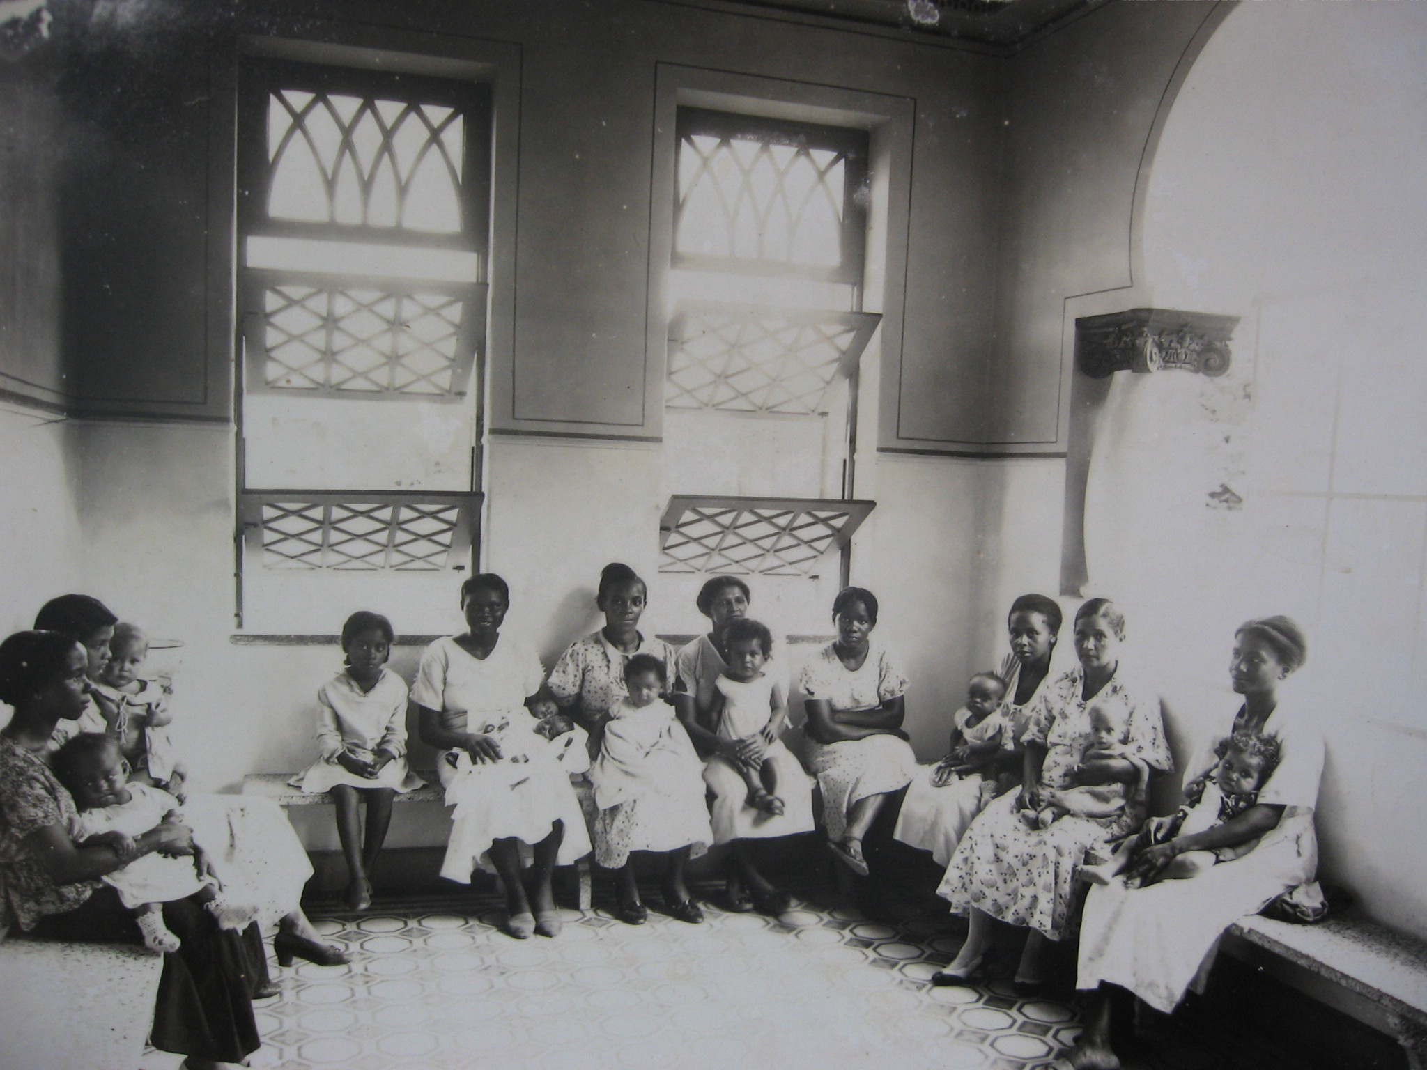
PUBLIC HEALTH AND SOCIAL MARGINALIZATION IN BRAZIL
DR. OKEZI T. OTOVO
FLORIDA INTERNATIONAL UNIVERSITY

Slide 2
“Health and disease have become powerful ways in which we map our world as well as regulate it.”
Randall McGowen
“Identifying Themes in the Social History of Medicine”
The Journal of Modern History (March, 1991), 90.

Slide 3
Areas of investigation
Social history: experiences of everyday women and men (and children!)
State and health policy
Environments and ecology (ex, resource access, risk, environmental justice)
Wellness/illness constructs (normal and deviant) as social control
legitimizing status differences (between races, genders, rich/poor, nations)
Process of naming and framing
Defining a disease and consequences for individuals, society, public health. Medicalization of society.

Slide 4
Themes for Modern Latin America
Medical pluralism
competition
state legitimacy
Medicine and power (alliance of state and elites)
Institutionalization and nation-building (medical systems, integration)
“hypermarginalization of the poor” Cueto & Palmer (2015)
gender, race, ethnic disparities.
International dimensions (unequal terms of trade)
national, (neo)colonial, global. Focus on epidemics.
Inflows and outflows

Slide 5
Context:
Brazil after abolition and empire to mid 20th century.
Nation-building, racial politics, and internationalization.
Major issues:
Maternalism, political and social change
Afro-Brazilian women and their children
Health movements as integration while solidifying its limits

Slide 6
“In some ways disease does not exist until we have agreed that it does, by perceiving, naming, and responding to it.”
Charles Rosenberg, Framing Disease, Illness, Society and History (1992)

Slide 7
Framing Disease (health and illness more broadly)
Disease: A biological event and a social phenomenon
Diagnosis and prognosis, making meaning of event
causation and specificity
Creation of explanatory and classificatory schemes
Occurs within an identifiable context

Slide 8
Naming Disease
Disease: A biological event and a social phenomenon
Relation to somatic condition, body as truth
Health care access and legitimacy
Naming reflects and incorporates values, attitudes, status relationships in wider culture
Who participates in naming disease?
What are implications?
Who bears responsibility?

Slide 9
Health and Society: How do we understand (experience) Zika?

