Slide 1
The Anatomy of a Revolution
Crane Brinton

Slide 2
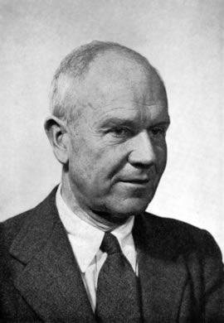
The Anatomy of a Revolution by Crane Brinton
Brinton is an American historian
His most famous work is a book called The Anatomy of a Revolution
He explains the “stages” that most revolutions take in order to be successful
The best example is probably the French Revolution

Slide 3
The Stages of a Revolution

Slide 4
I. The Old Regime
Economically weak
Politically weak
Intellectuals desert
Class antagonisms

Slide 5
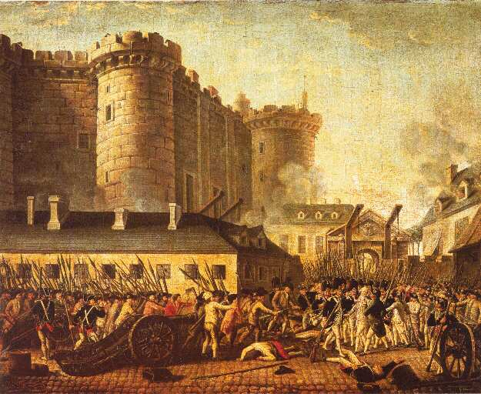
II. First Stages
Symbolic actions
Planning
The Role of Force

Slide 6
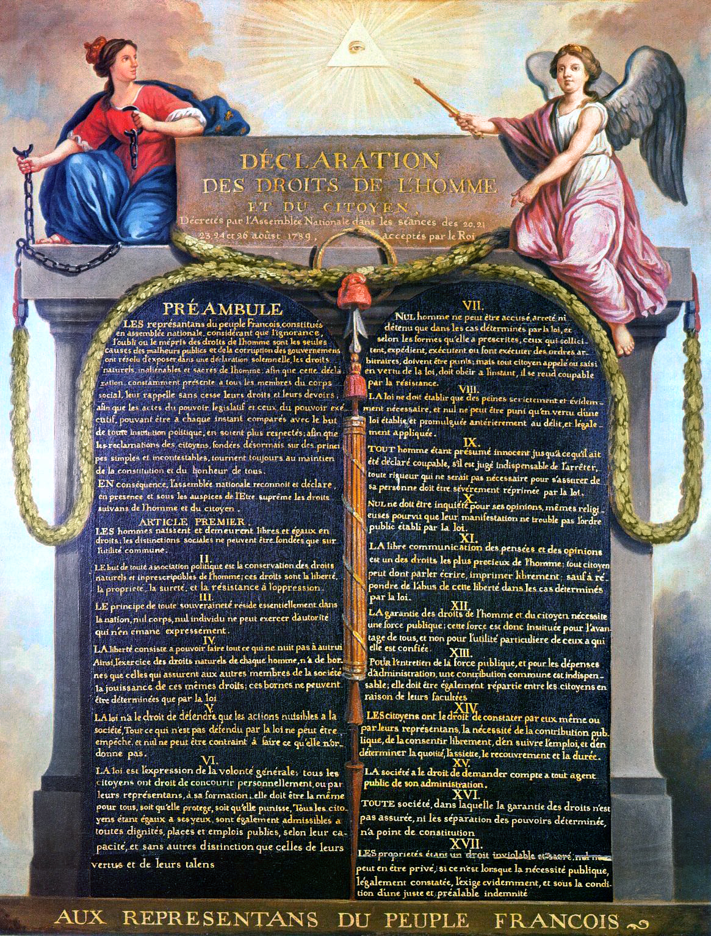
III. The Rule of the Moderates
Dual sovereignty
A better organized government takes over
Moderates take over
Write a new constitution
Fight a war

Slide 7
IV. Rise of the Radicals
Coup d'état
The radicals seize power
Organization
How do they run things?

Slide 8
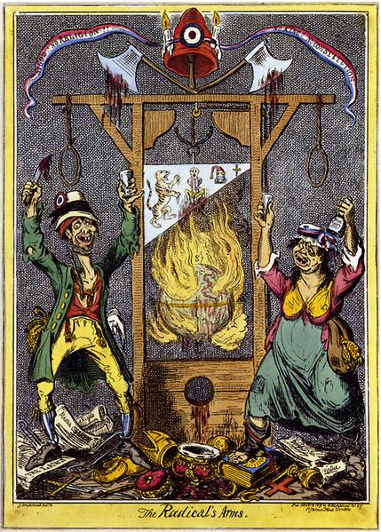
V. The Reign of Terror
Forced conformity
Spreading the beliefs of the revolution
Causes of the terror

Slide 9
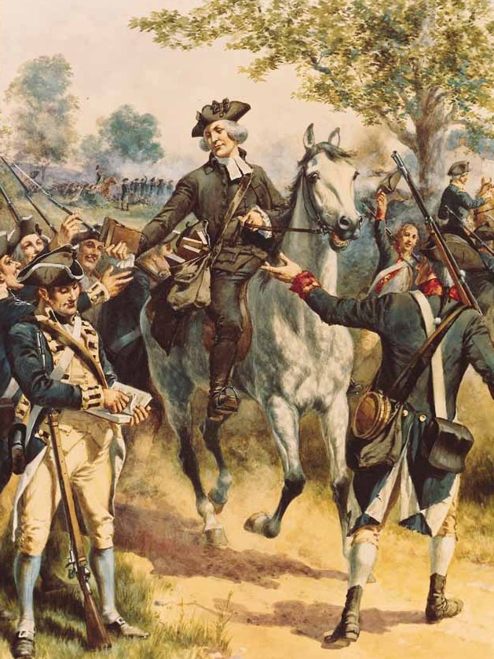
VI. Cooling Off Period
First recovery from the revolution
Amnesty or repression?
Return to the status quo?

Slide 10
Argumentative Writing Classwork
On the same sheet of paper, write a paragraph or two about which phase you believe is the most important to a revolution. Make sure to explain your answer in detail—try to use examples.

