Slide 1
The Cuban Revolution

Slide 2
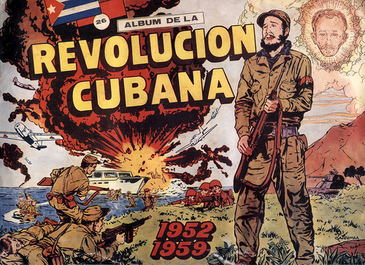

Slide 3
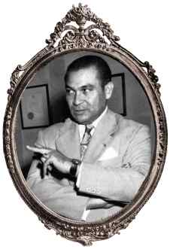
Fulgencio Batista
In an uprising known as the “Revolt of the sergeants,” batista took power of the Cuban government in 1933.
The coup marked the beginning of the army’s influence as running the government.
In 1952 Batista took control of the government once more in a second coup.
He seized power through a coup after realizing that he would loose his power as president of cuba.
Batista was liked by American Interests as well as the mafia.

Slide 4
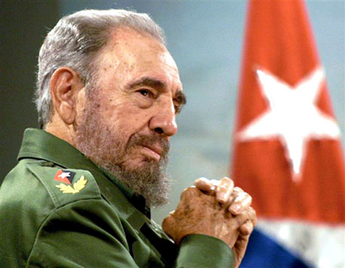
Fidel Castro
Castro was born to an upper class family.
He studied law in university.
He organized a plan to take down batista.
He and his brother, raul castro, organized a plan and got followers, called rebels, to help carry out the plan.
This started the Cuban revolution

Slide 5

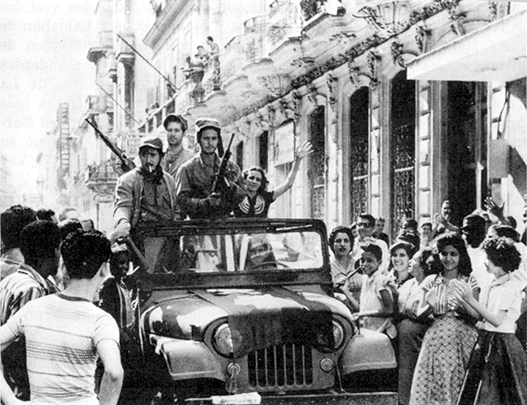

Slide 6
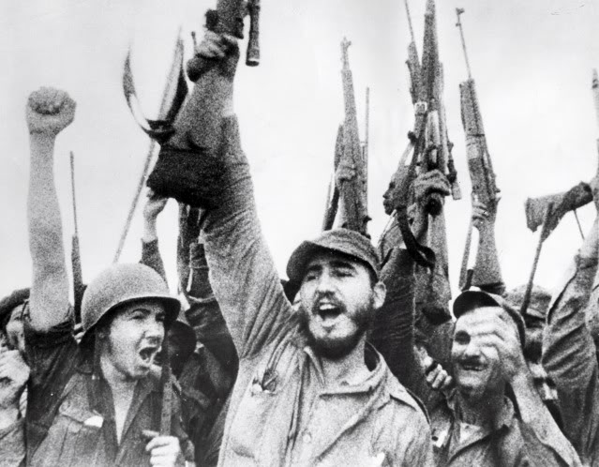
The revolution
A year into Batista’s second coup, the rebels attacked moncada army barracks.
The attack failed and batista instilled the 10-for-1 law.
  10 rebels would be killed for every one soldier dead.
The rest of the rebels were sent to jail, including the castro brothers.

Slide 7
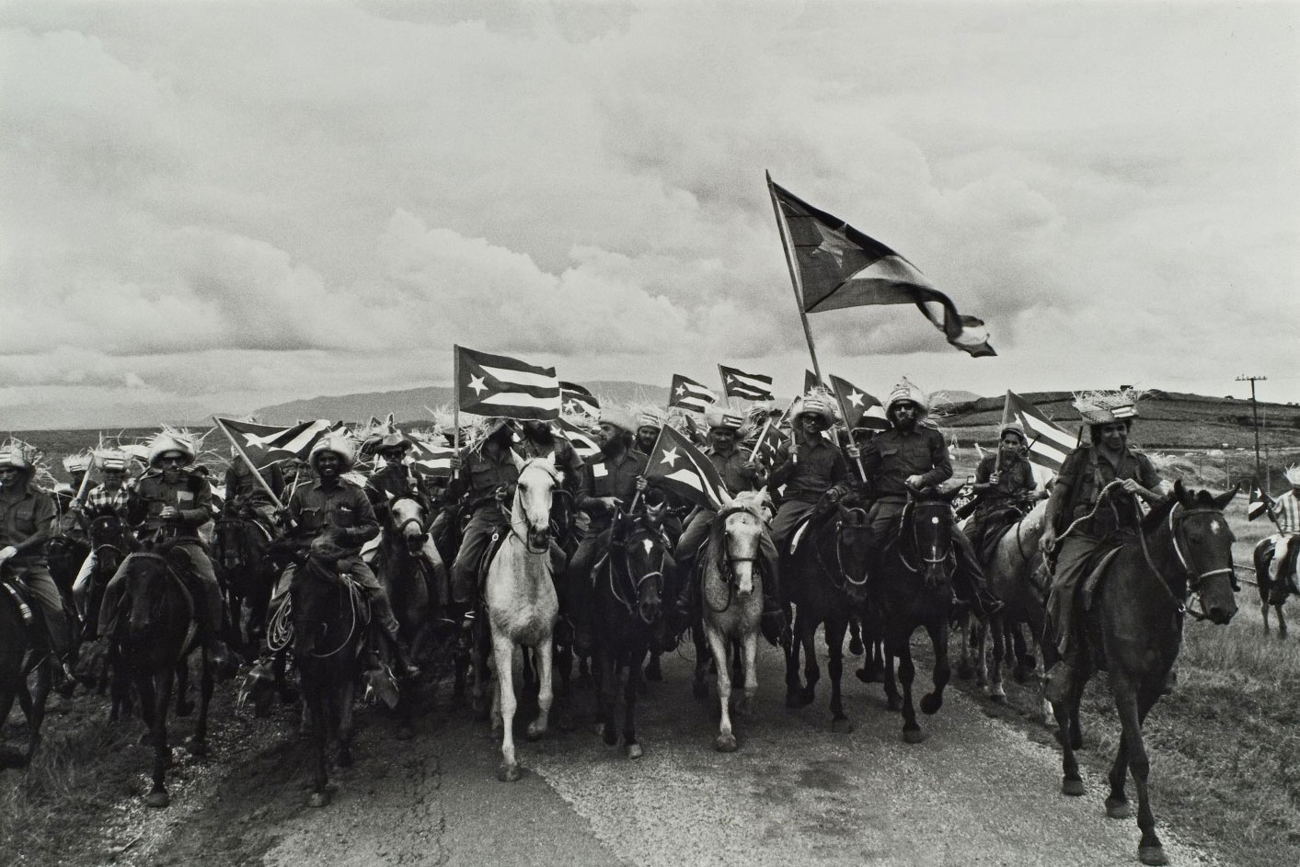
When the castro brothers and other rebels were released from prison, they regrouped in mexico and planned another attack
  Here they met Che Guevara
The rebels took off into the wooded central highlands where batista could not flush them out.
The rebels defeated the soldiers and batista fled the country
Fidel castro then declared himself president for life.

Slide 8
