Slide 1
The Real Failure in Central America
José Miguel Cruz
Florida International University

Slide 2
What is the problem with Northern Central America?
The most violent region of the world
One of the poorest regions in Latin America
Massive emigration to the United States
In 2014, 76% children in the Mexico-U.S. border came from Guatemala, El Salvador, and Honduras

Slide 3
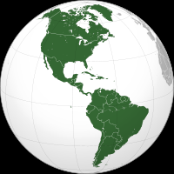
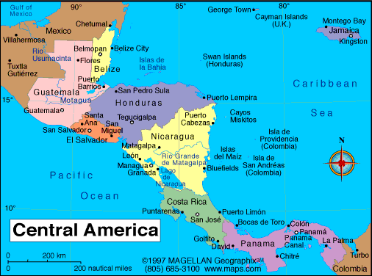

Slide 4
Country | Rate
Honduras | 82
El Salvador | 66
Venezuela | 49
Guatemala | 42
Colombia | 33
Brazil | 23
Dominican Republic | 25
Panama | 22
Ecuador | 18
Mexico | 18
Nicaragua | 11
Paraguay | 12
Costa Rica | 9
Bolivia | 9
Uruguay | 6.1
Argentina | 5.5
Peru | 5.2
United States | 4.5
Chile | 3.7
Canada | 1.8
Homicide Rates in
Latin America, 2010-2013
Rates per 100,000 inhabitants
World Homicide Rate: 6.9
Source: UNODC, 2013 Global Study on Homicide

Slide 5
The Northern Triangle has been violent since the 1990s
Source: Cruz, 2011

Slide 6
The problem of violence in Central America
Many actors, few data
“Social violence” (senseless acts of violence)
Youth gangs
Criminal organizations

Slide 7
The usual explanations
Most explanations about current violence and the crisis focus on:
Poverty and inequality
Legacies of Civil War
Migration and deportation (Gangs were imported from the United States)
Penetration of drug cartels in Central America from Mexico

Slide 8
Economic Indicators (last available data)
Country | GDP per capita (US$) (2013) | GDP Growth (Average % 2010-2013) | Pop. Living with $2/day (%) | Income inequality index)
Mexico | 8,519 | 4.0 | 4.1 | 48.1
Guatemala | 3,478 | 3.5 | 29.8 | 52.4
El Salvador | 3,826 | 1.8 | 8.8 | 41.8
Honduras | 2,291 | 3.6 | 29.2 | 57.4
Nicaragua | 1,851 | 4.6 | 31 | 43
Costa Rica | 10,185 | 4.6 | 3.1 | 48.6
LAC region | 7,500 |  |  | 51
USA | 53,042 |  | 1.7 | 45
Source: World Bank Economic Indicators and UNDP Human Development Report

Slide 9
Human Development Indicators
Country | Ranking (1-182) | Life expectancy females (years) | Literacy rate (%)
Guatemala | 122 (Medium) | 75 | 73
El Salvador | 106 (Medium) | 77 | 82
Honduras | 112 (Medium) | 76 | 83
Nicaragua | 124 (Medium) | 78 | 78
Costa Rica | 54 (High) | 82 | 96
LAC region |  | 79 | 85
USA | 13 (Very high) | 82 | 99
Source: UNDP Human Development Report

Slide 10
Some indicators…
 | Guatemala | El Salvador | Honduras | Nicaragua | Costa Rica
Indicators of economic performance
GDP per capita (2007) | 3,341 | 3,782 | 2,389 | 1,777 | 9,443
Gini Index | 54.5 | 52.2 | 55.3 | 54.5 | 48.5
Average Growth of GDP (1990-2009) | 3.75 | 2.94 | 3.70 | 3.16 | 5.31
Indicators of war-legacies
Demobilized soldiers (n) | 14,000 | 24,500 | n/a | 72,720 | n/a
Guerrillas/Contras (n) | 500 | 12,362 | n/a | 19,000 | n/a
Paramilitaries (n) | 279,421 | 30,000 | n/a | 0 | n/a
Total (n) | 293,921 | 66,862 | n/a | 91,726 | n/a
Source: PNUD 2009

Slide 11
Indicators of state infrastructure in security
Indicators of institutional infrastructure | Guatemala | El Salvador | Honduras | Nicaragua | Costa Rica
Police officers per 100,000 pop. | 152 | 300 | 118 | 155 | 277
Judges per 100,000 pop. | 6 | 10 | 9 | 6 | 17
Public attorneys per 100,000 pop. | 1 | 4 | 3 | 2 | 6
Average percentage of public spending on security in national budget (2006-2007) | 9.9 | 14.3 | 8.0 | 8.1 | 7.7
Average police officer monthly wage (in US$) | 470 | 470 | 280 | 150 | 584
Source: PNUD 2009; Cruz 2010

Slide 12
Gangs in Central Ameriica
Usually blamed for the problem of violence
The prevailing narratives are:
They are the result of migration
MS-13 and 18th Street Gangs are a imported problem
They took over and control the streets in Central America

Slide 13
Front page in El Salvador 1988

Slide 14
What systematic data say
The problem is more complex than that
No more than 15% Central American gangs have been outside their countries
Not the only actors of violence, even when they contribute significantly

Slide 15
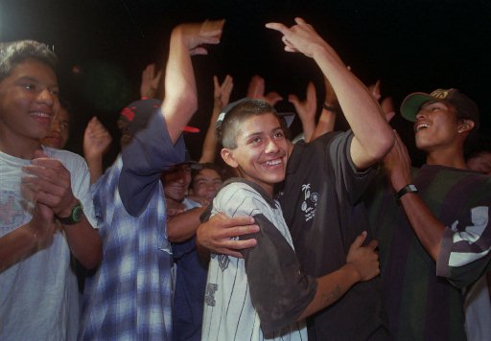
Mara Salvatrucha and 18th Street Gang members celebrating their peace agreement in San Martin, San Salvador, 1996.

Slide 16
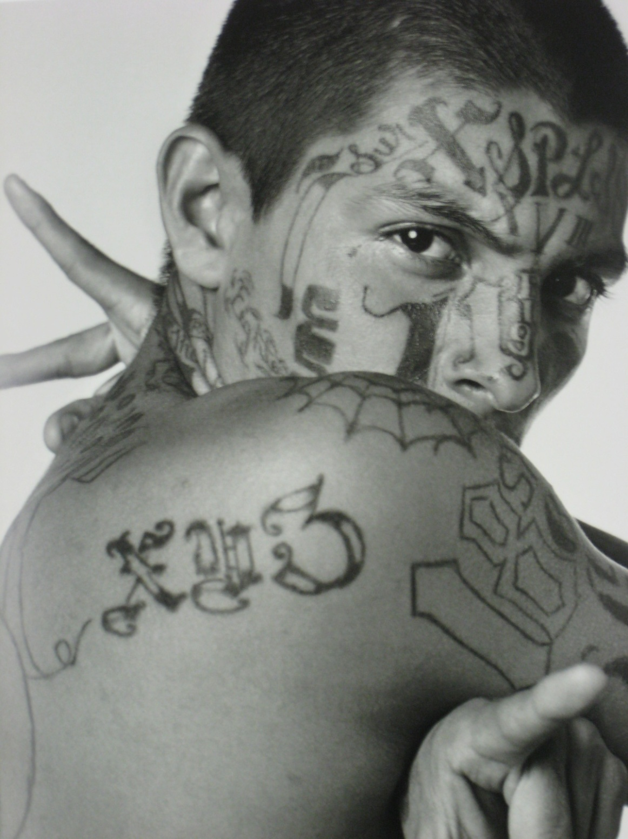
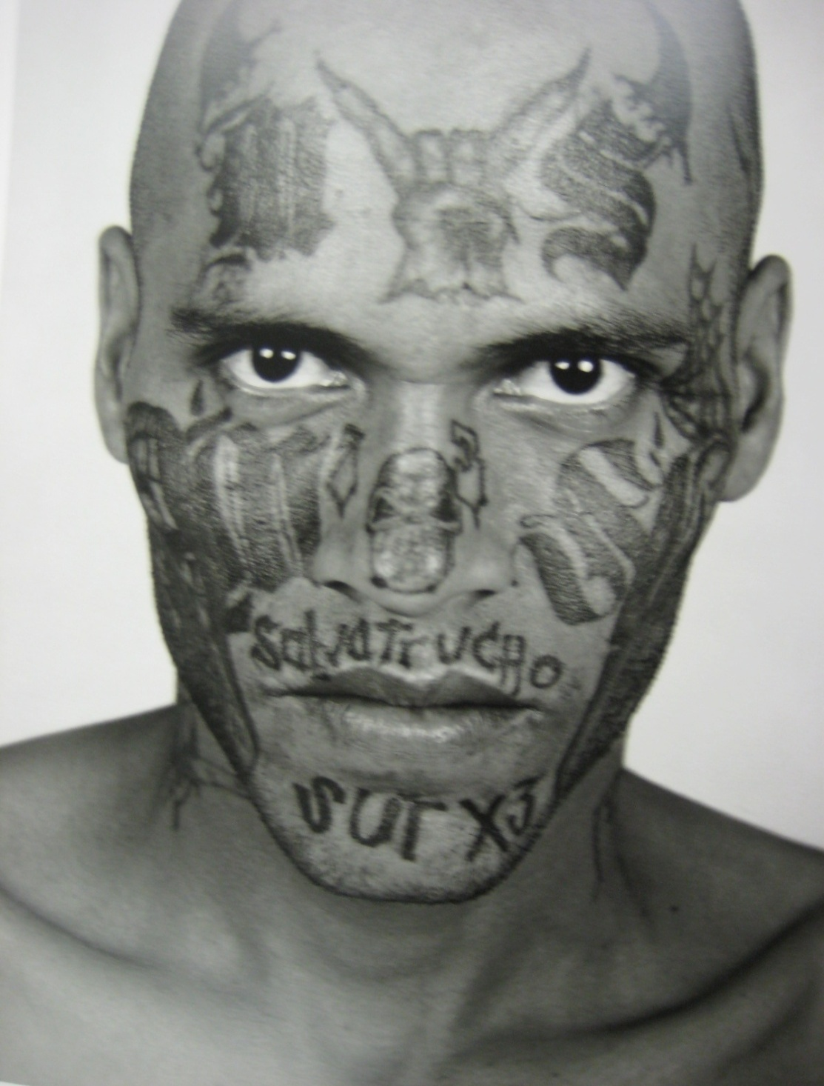
…To Organized Crime: Gang members in Salvadoran prisons, 2006 (Photographs by Isabel Muñoz)
Notes:
Edited header

Slide 17
Explanations are more complex than that:
Gangs are not the cause but the symptom of a myriad of structural causes
But the decisive factor in their evolution is:
Public Security Policy

Slide 18
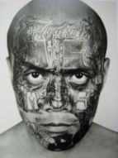
“The heart of the Eighteenth was there…”
Country/City “A”
Country/City “B”
Chalatenango
18th Street National
Prison
Country/City “C”

Slide 19
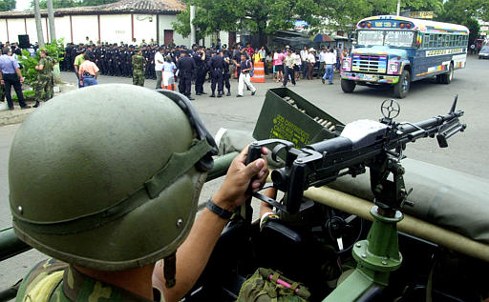
Deployment of Mano Dura in El Salvador, July 2003

Slide 20
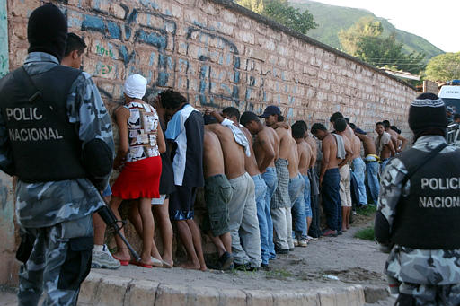
Zero Tolerance Crackdown in Honduras, 2003

Slide 21
Stages in the evolution of gangs
Stage | Period | Respnse
Street corner gangs | 1980s-1994 | Indifference
Constitution of maras | 1994-2000 | Swing between crackdowns and indifference
Organizational incubation | 2000-2008 | Mano Dura
Territorial consolidation | 2009- | Swing between mano dura, prevention, and negotiartion

Slide 22
Homicides and Extortions reported to the police in El Salvador, 1998-2011
Source: Policia Nacional Civil

Slide 23
Percentage of gang-related homicides, El Salvador 1999-2008
Source: Instituto de Medicina Legal, 2008

Slide 24
Gangs have developed into organized crime organizations in contexts in which State institutions, via draconian policies and illegal violence, have provided them with incentives, opportunities and legitimacy.
Notes:
Edited

Slide 25
The Real Failure in Central America
José Miguel Cruz
Florida International University

