Slide 1
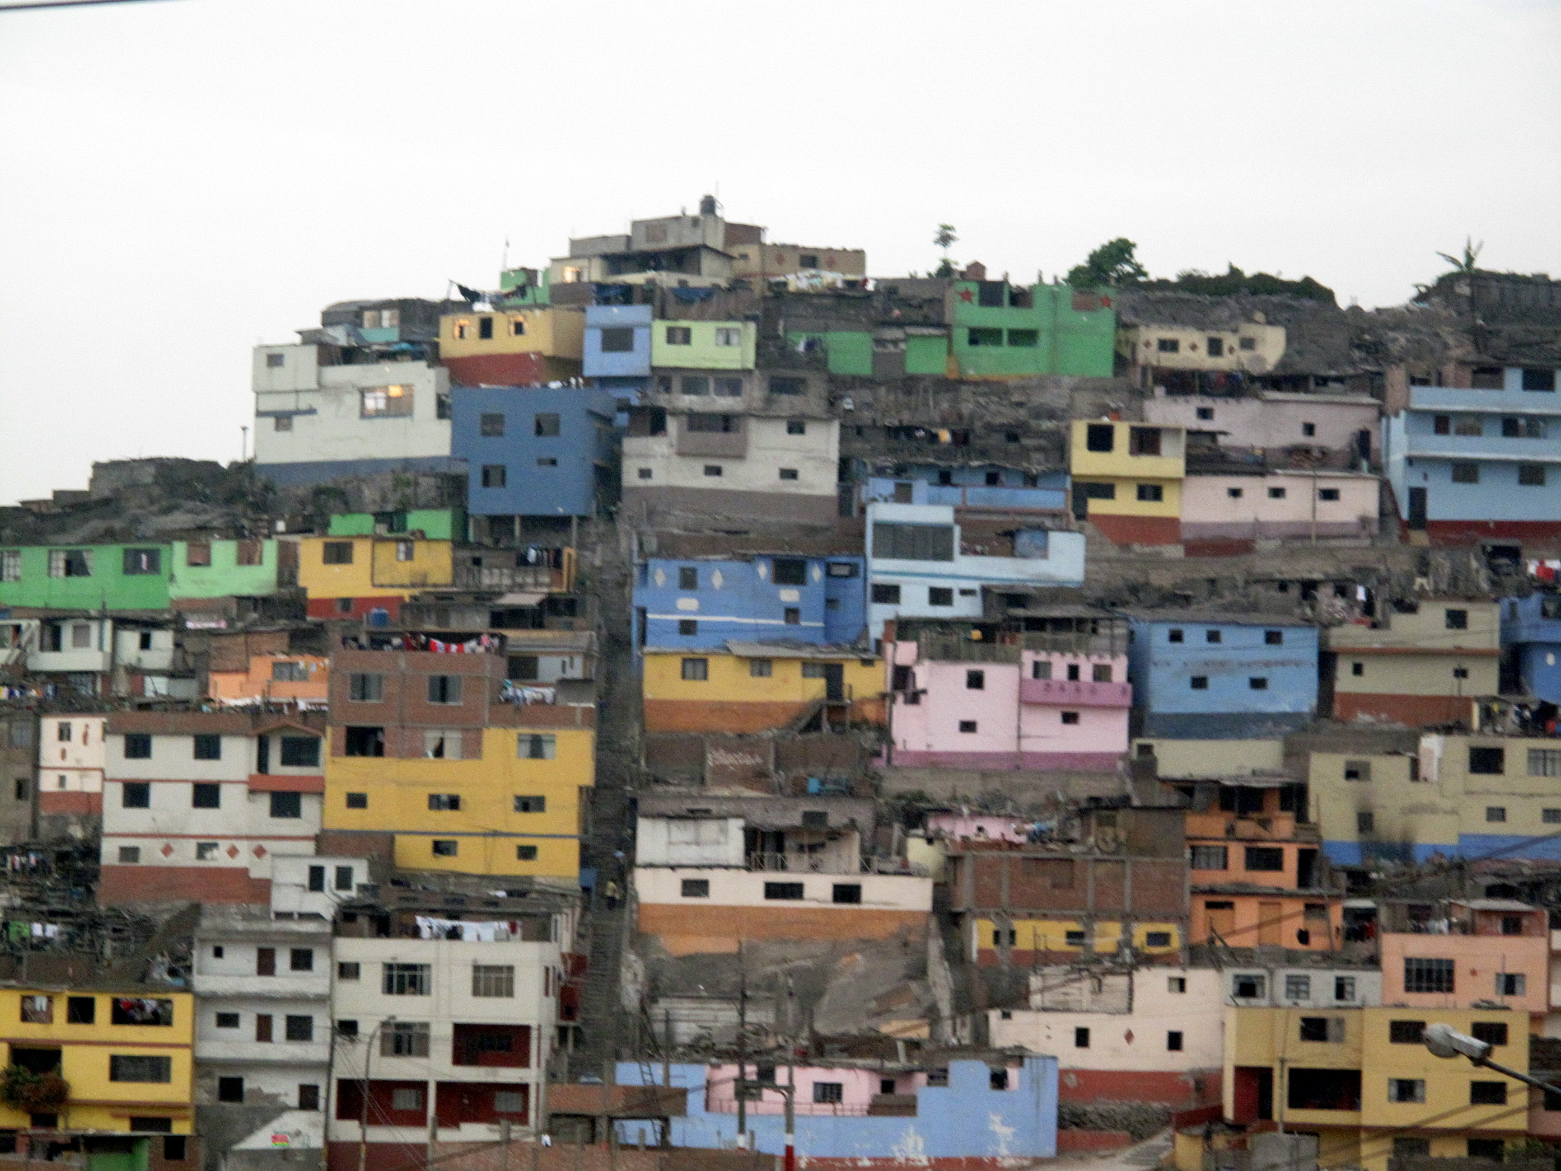
TRANSFORMING COMMUNITIES:
HAITI
Dimmy Herard
Disaster Risk Reduction Program
Extreme Events Institute
Florida International University

Slide 2
INFORMALITY IN LATIN AMERICA
By 2050, 69% of the world’s population of 9.6 billion will be urban, mostly in the developing world.¹
Latin America is one of the most urbanized regions in the world, with about 80% of its population living in cities.
By 2020, it is estimated that over 160 million households in the region will live in informal settlements.
Notes:
“Urban and Rural Areas 2009.” United Nations, Department of Economic and Social Affairs, Population Division. http://www.un.org/en/development/desa/population/publications/urbanization/urban-rural.shtml.

Slide 3
Informal settlements have typically been defined by what they lack:
Durable housing
Sufficient living space
Access to safe water
Access to adequate sanitation
Security of tenure¹
Notes:
1. United Nations Human Settlements Programme (UN-HABITAT). “Affordable Land and Housing in Latin America and the Caribbean.” (2011): 64.

Slide 4
INFORMALITY AND DISASTER IN HAITI
Port-au-Prince grew from 250,000 inhabitants in the 1950s to over 2 million in 2010.¹
A 1997 study found that 67% of the city’s population lived in spontaneous settlements.²
Informal settlements are often built in disaster prone locations.
Notes:
CNN World. Haiti was ‘catastrophe waiting to happen.’ (January 12, 2010). Retrieved from http://articles.cnn.com/2010-01-12/world/haiti.earthquake.infrastructure_1_building-poverty-line-catastrophe/2?_s=PM:WORLD.
Government of the Republic of Haiti. Haiti earthquake PDNA: assessment of damage, losses, general and sectoral needs. (2010): 73. Retrieved from http://siteresources.worldbank.org/INTLAC/Resources/PDNA_Haiti-2010_Working_Document_EN.pdf.

Slide 5
INFORMALITY AND DISASTER IN HAITI
Half of informal settlements in Port-au-Prince are located on unstable hillsides or at the bottom of drainage ravines.
The devastation of the 2010 magnitude 7.0 earthquake represents the convergence of high rates of informality, vulnerability, and disaster risk.
More than 230,000 people died in the aftermath, another 1.5 million were made homeless.
Notes:
CNN World. Haiti was ‘catastrophe waiting to happen.’ (January 12, 2010).
Government of the Republic of Haiti. Haiti Earthquake PDNA: Assessment of Damage, Losses, General and Sectoral Needs. (2010).

Slide 6
RAVINE PINTADE AND THE “KATYE” PROJECT
USAID forced to address complexities of reconstruction and recovery, and limitations of the sectoral approach
Shifted from viewing rubble removal simply as a logistics problem, to a larger social question
Project expanded to deal with questions of relocation/displacement, land tenure, livelihoods, social connections

Slide 7
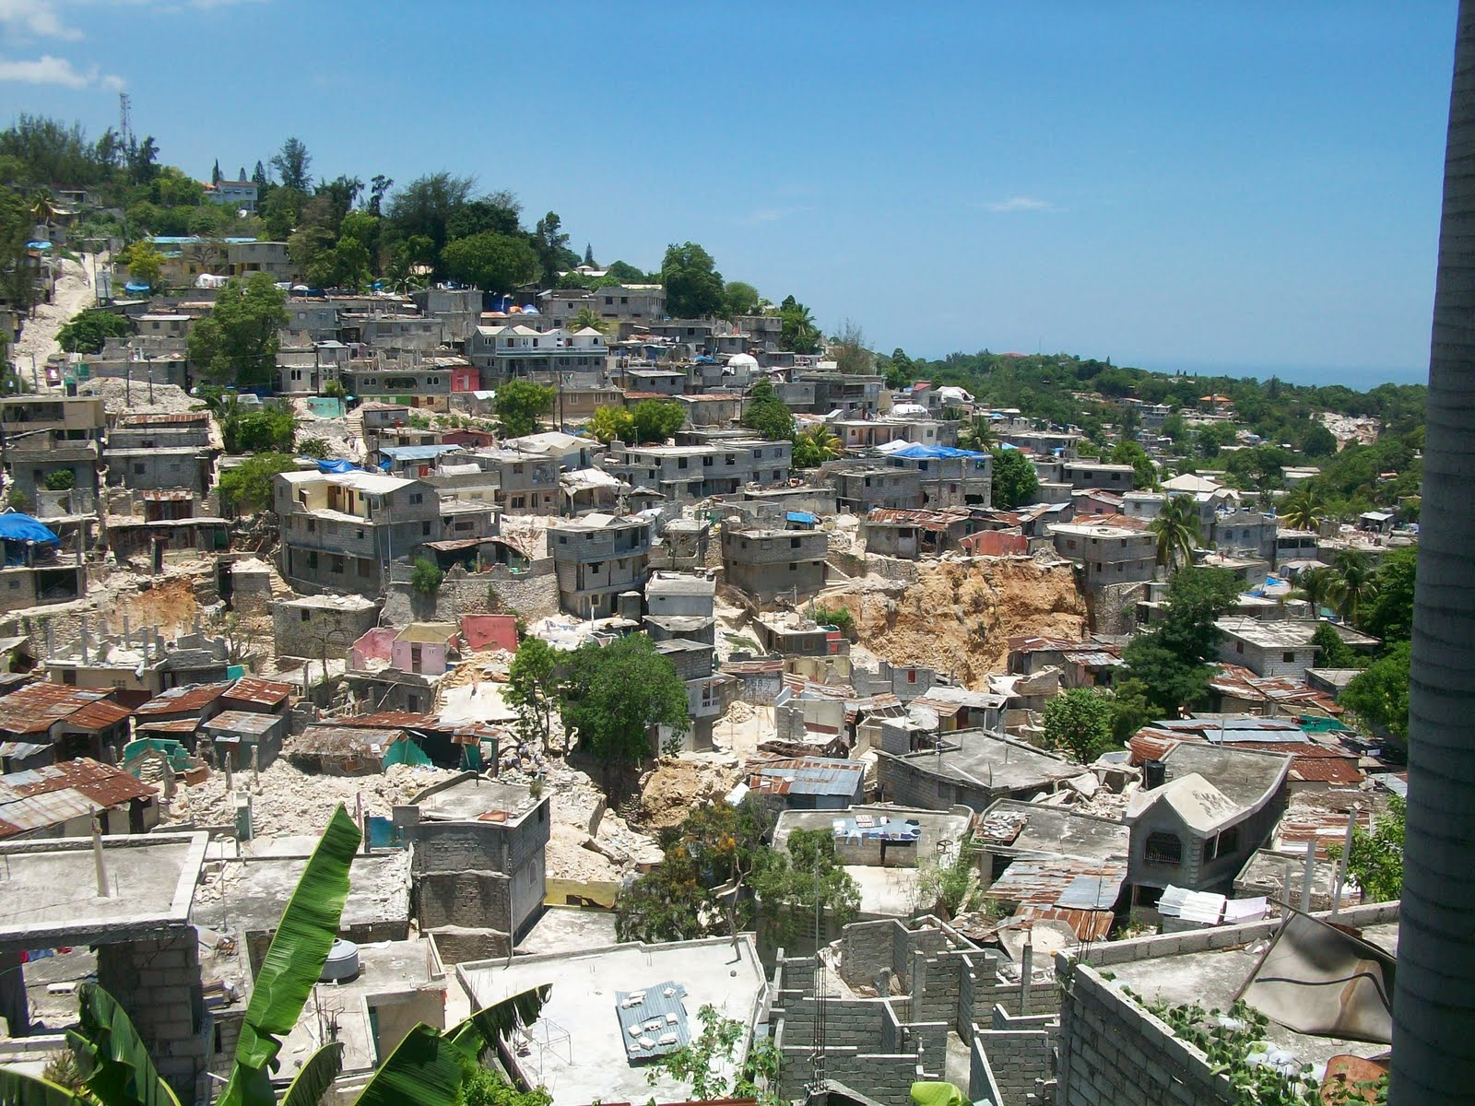
Ravine Pintade
Notes:
http://www.benandkatieinhaiti.com/2010/05/ravine-part-1.html

Slide 8
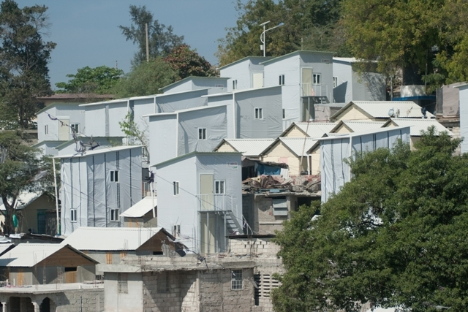
T-Shelters
Notes:
https://www.flickr.com/photos/chfinternational/sets/72157629848923756/

Slide 9
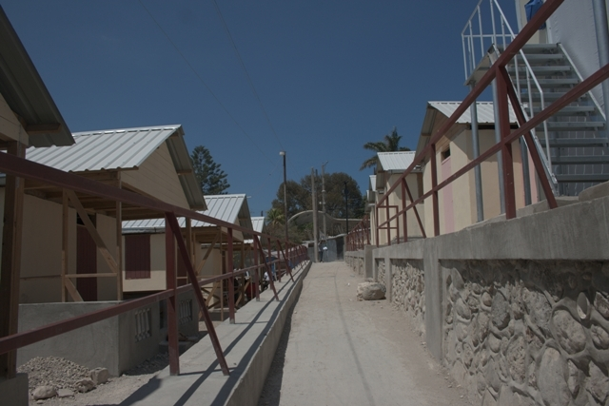
Paved Walkways
Notes:
https://www.flickr.com/photos/chfinternational/sets/72157629848923756/

Slide 10
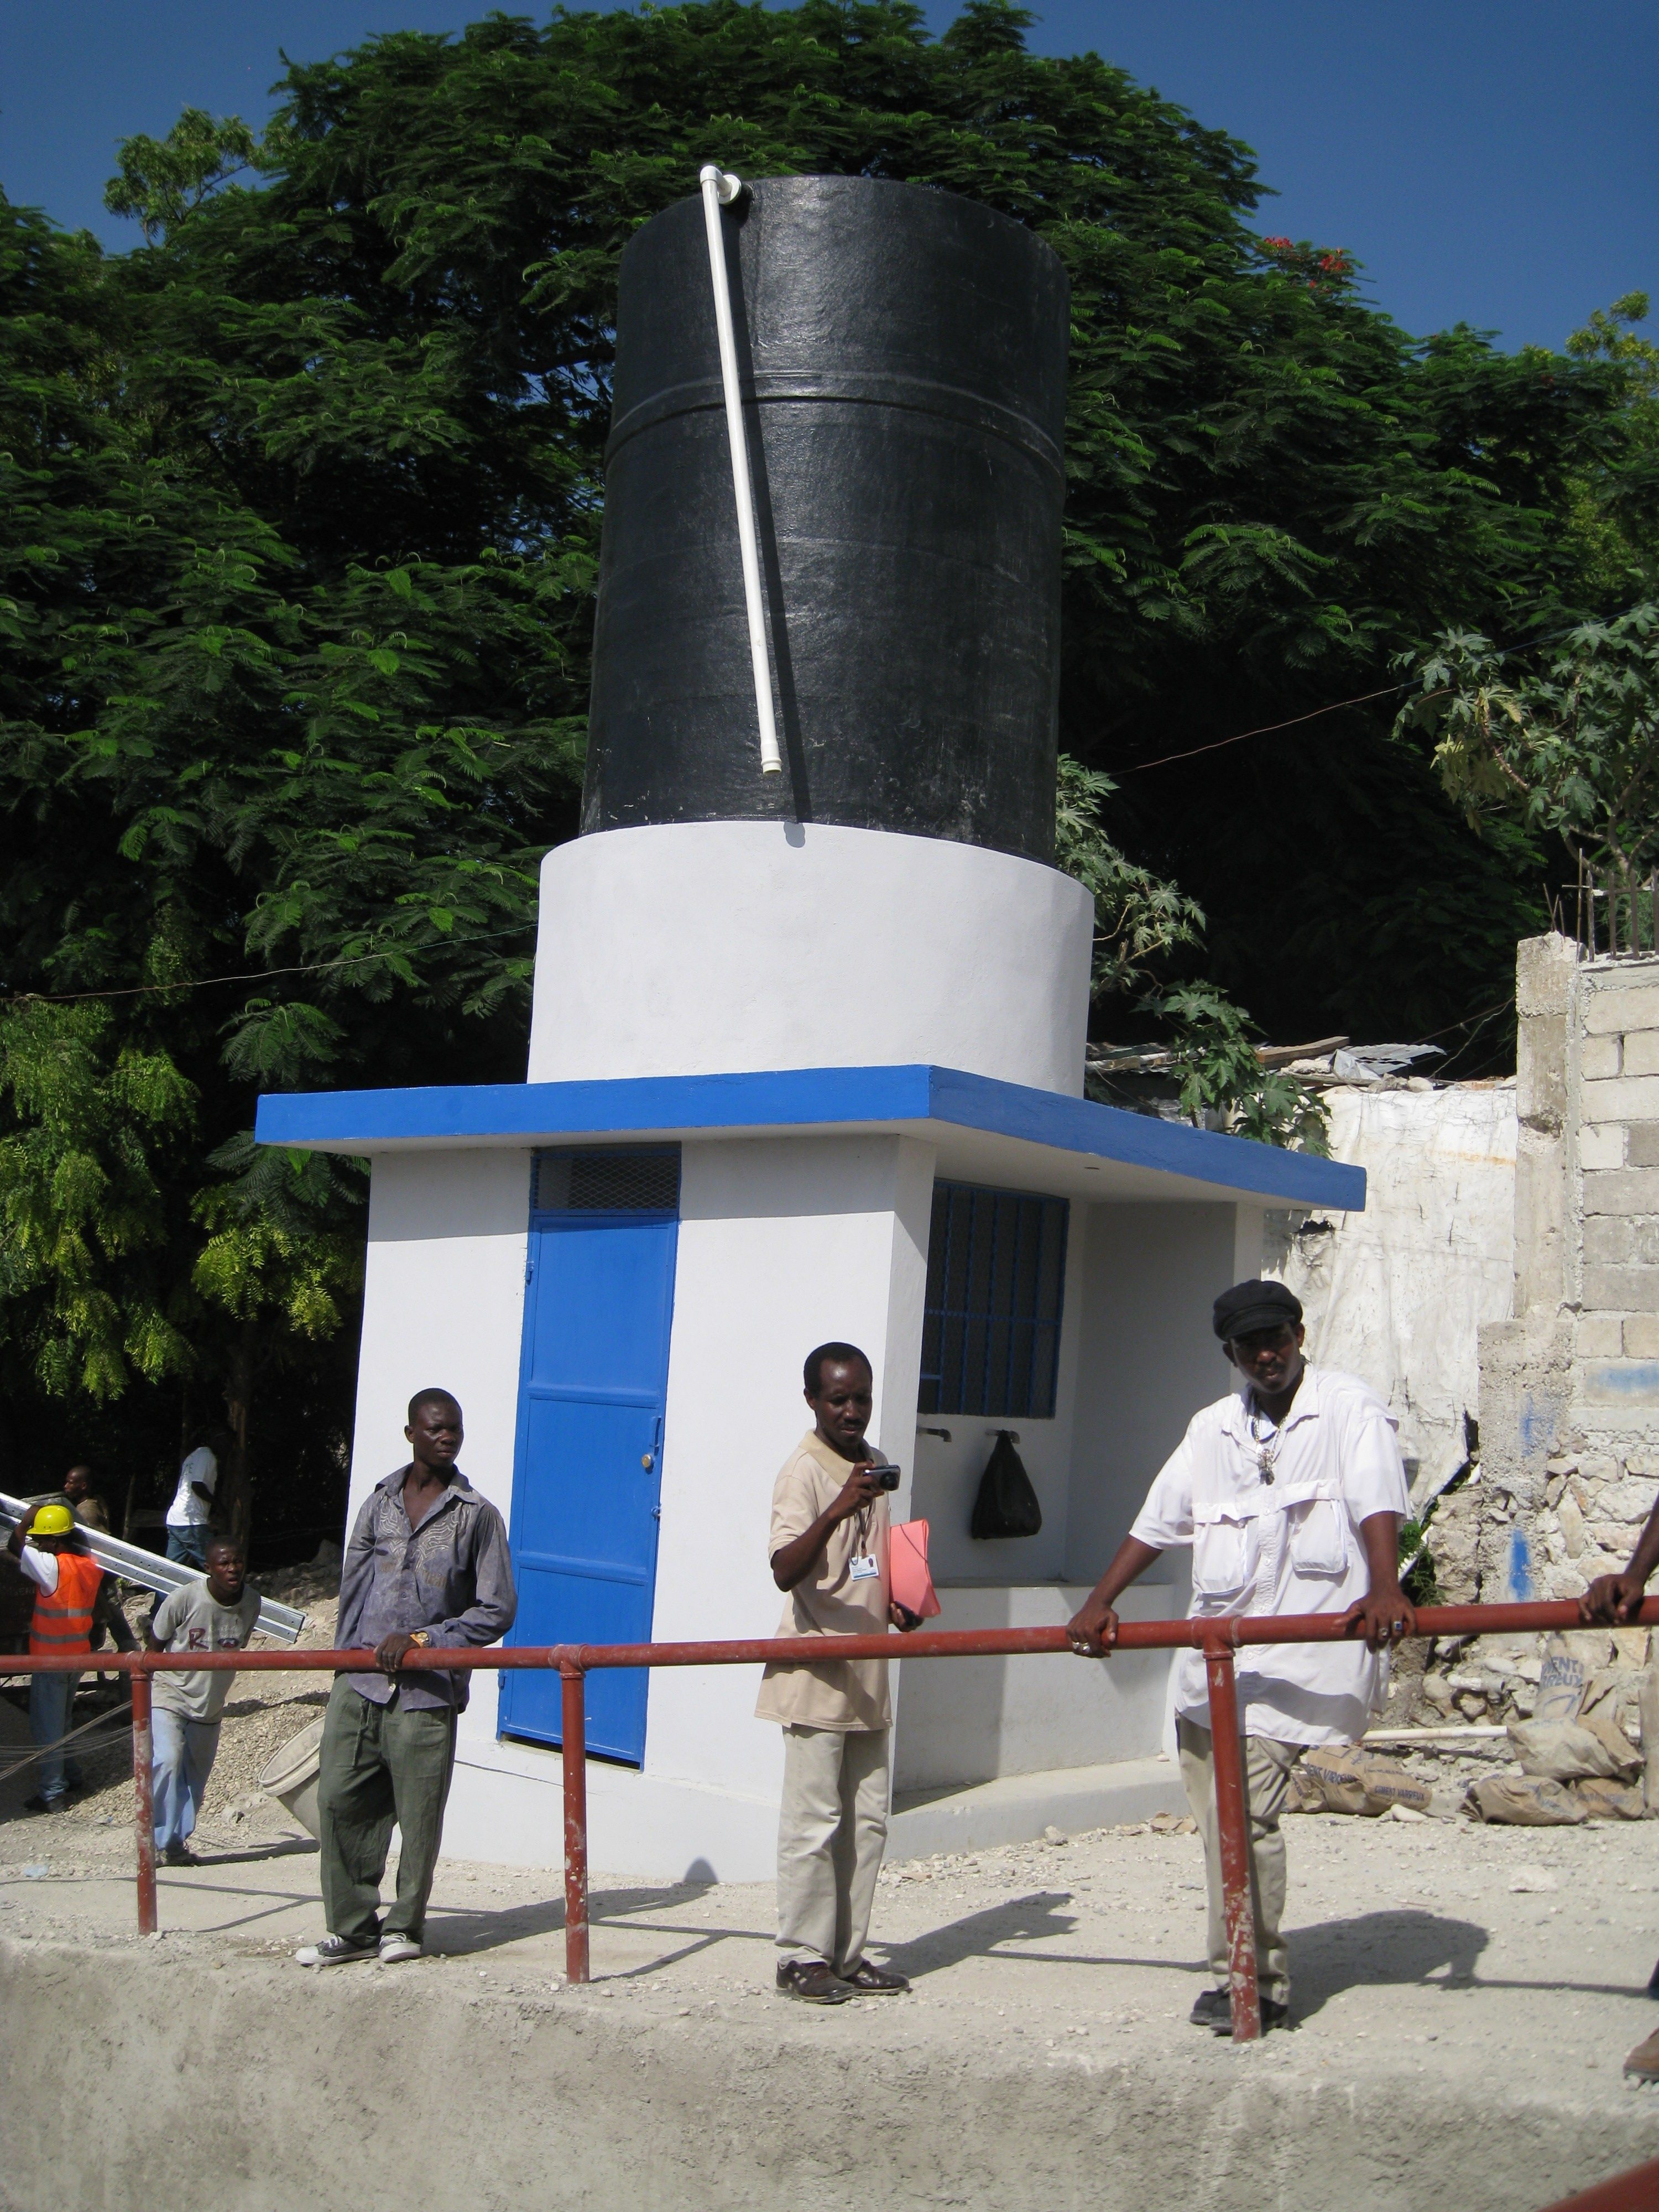
Water Tower
Notes:
https://www.flickr.com/photos/chfinternational/sets/72157629848923756/

Slide 11
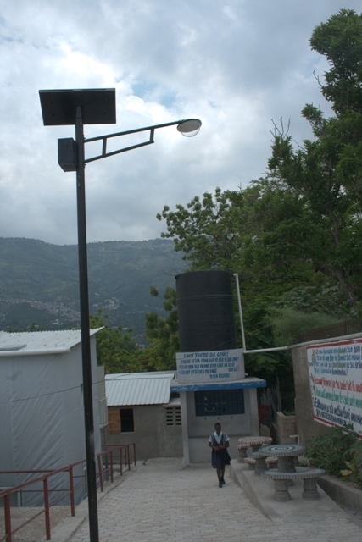
Light Poles,
Water Distribution
Points
Notes:
https://www.flickr.com/photos/chfinternational/sets/72157629848923756/

Slide 12
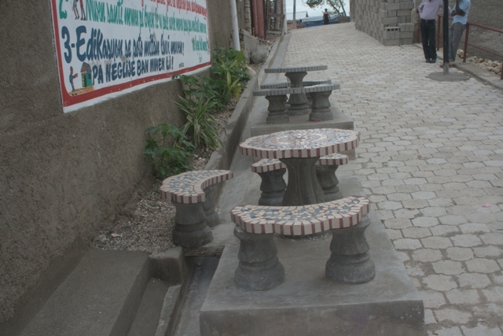
Benches and
Public Spaces
Notes:
https://www.flickr.com/photos/chfinternational/sets/72157629848923756/

Slide 13
EMERGENCE OF THE NEIGHBORHOOD APPROACH
In 2011, USAID launched an initiative to support urban DRR projects across Latin America and the Caribbean using a “neighborhood approach.”
The “neighborhood approach” is defined as an integrated multi-sectoral participatory planning process.

Slide 14
Sectoral Components:
Shelter and Settlements
Economic Recovery and Market Systems
Water, Sanitation, and Hygiene (WASH)
Disaster Risk Reduction served as a cross-cutting component

Slide 15
FIU’s Disaster Risk Reduction Program conducted a sistematización of the neighborhood approach through 2 years of project implementation in 4 urban contexts throughout the Americas:
The Villa El Salvador district of Lima, Peru
Mixco, Guatemala
Quetzaltenango, Guatemala
Anse-à-Foleur and Port-de-Paix, Haiti

Slide 16
What is sistematización?
Its origins trace back to Latin American schools of social work and popular education; related to the field of evaluative research.
While an evaluation’s purpose is to determine success or failure, sistematización seeks to understand the “how’s and why’s” of the process.

Slide 17
Cross-cutting Themes Critical to a Neighborhood Approach”
Participation
Governance
Social Inclusion
Sustainability

Slide 18
Cross-Cutting Issues | PRE-PROJECT: Identify and nurture pre-existing relationships | SENSITIZATION: Introduce project goals to stakeholders | IMPLEMENTATION: Core project activities and their management | TRANSFER: Actualizing the transfer of responsibility to local partners | POST-PROJECT: Maintain project outcomes beyond implementation
PARTICIPATION: focuses on the degree to which DRR projects are community-based | Is there any history of local collective action (not related to disasters)? To what degree are community groups formally recognized by local, regional, or national governments? | What pre-existing social networks were used to connect with the community? To what degree have local communities been informed about the neighborhoods project and urban risk reduction? | Have local communities been incorporated in the implementation of the neighborhoods approach? Are local communities being incorporated in urban planning and DRR decision-making processes? | Are there any formalized mechanisms for transition/ transfer established? What kinds of steps were taken to facilitate ownership? | What kind of measures will be taken to ensure that some kind of relationship remains between the aid agency and local partners?
Systematization Matrix

Slide 19
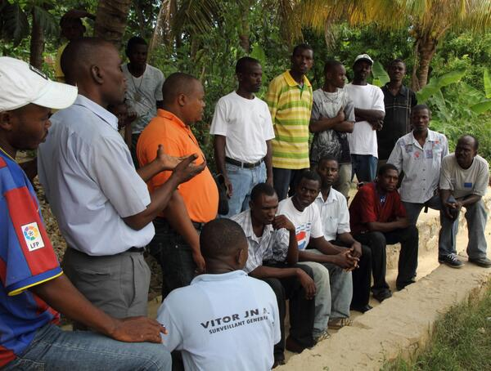
Local Civil Protection
Committee

Slide 20
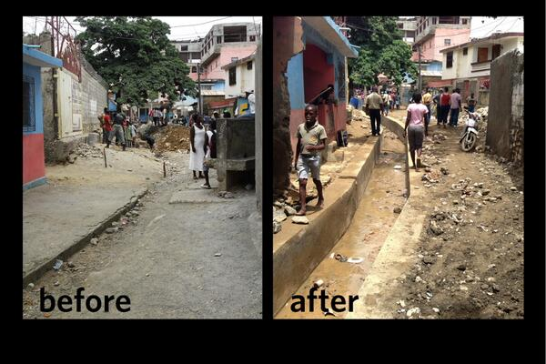
Drainage Canals

Slide 21
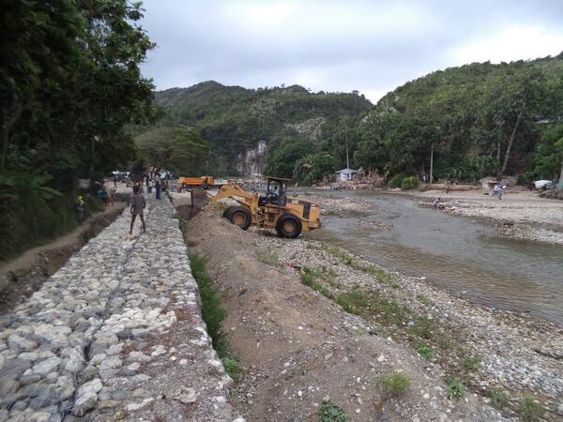
Gabions

Slide 22
CONCLUDING REMARKS
The neighborhood approach acknowledged the complexity of informal urban landscapes
Rejects the informal-formal binary
Moves project beyond emphasis on quantitative indicators and outcomes to address qualitative questions of process

Slide 23
THANK YOU

