Slide 1
Two Sides to Every War
Latin America
Liani Calvo

Slide 2
Cuba

Slide 3
Cuba
Location
Fertility
Spanish presence declining
Democrats became interested
1830s – 1840s
On the USA’s list behind acquisitions on
Texas
Oregon
The Mexican Cession

Slide 4
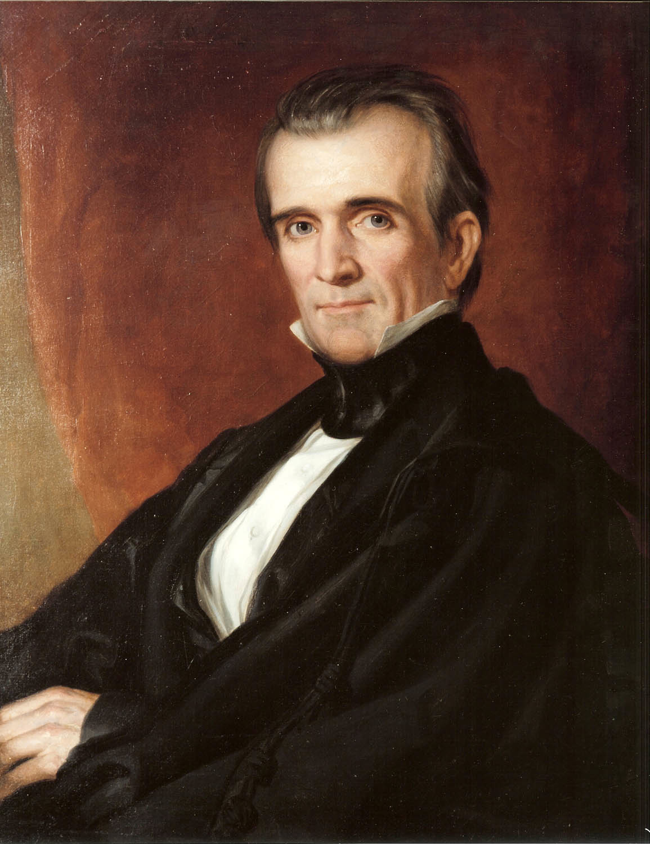
James Polk
Democrat
Elected in 1844
1845-1849
“Dark Horse”
Governor of Tennessee
Focused on acquiring
Cuba

Slide 5
Hook vs. Crook
Hook
Polk attempted to purchase Cuba from Spain
Crook
Americans and non-Americans
Private arms and armies
Hook
Franklin Pierce reattempted to buy Cuba
Ostend Manifesto in 1854

Slide 6
